Slide 1
Search for Requisitions and POs
The Manage Requisitions page allows you to access and view the Purchase Order created from a previously created Requisition. The page also allows you to see why a Purchase Order was not created (for example, while a Requisition was routing for approval, it was canceled by an initiator or rejected by an approver).
The Manage Orders area provides similar options to the Requisition page but with some additional features when viewing the Purchase Order. It also allows you to see a created Purchase Order that has not been issued and is still in review by Procurement and Contracting Services.

Slide 2
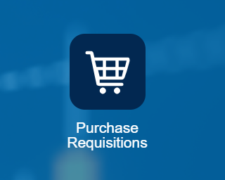
Search for Requisitions and POs
Manage Requisitions
Log into Aggie Enterprise
Click Procurement, and then click Purchase Requisitions.

Slide 3
Search for Requisitions and POs
Manage Requisitions
Click Manage Requisitions.

Slide 4
Search for Requisitions and POs
Manage Requisitions
On the Manage Requisition page, click Advanced to select whether to use Starts with, Contains, or Ends with search criteria.
Entered By displays the name of the signed-in user by default, but you can change it to search for Requisitions created by another user. This is the recommended field for returning the most meaningful data, because there isn’t a way to search against all orders created by a specific department or account.
Requisition is useful if the Requisition number is available.
Supplier is useful to see all Purchase Orders issued to a specific supplier.
Order lets you enter the PO number.

Slide 5
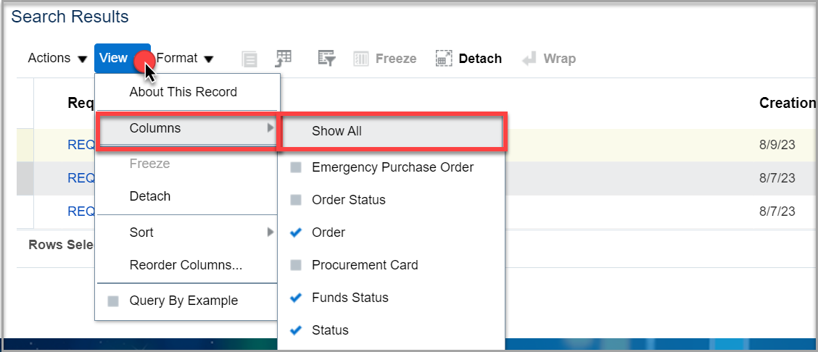
Search for Requisitions and POs
Manage Requisitions
After you finish setting the search criteria, click Search. The search results appear.
On the search results page, click View, and then choose Columns > Show All to see all the information available. The Order column displays the Purchase Order number, if assigned.

Slide 6
Search for Requisitions and POs
Manage Requisitions
Click the PO number to view details about the PO.

Slide 7
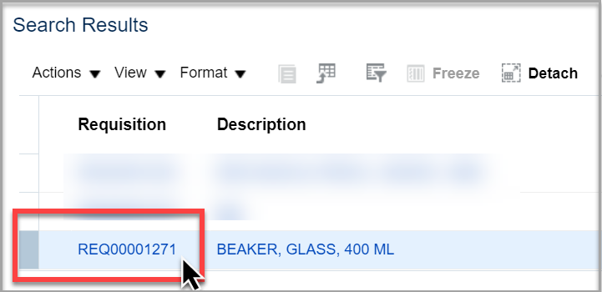
Search for Requisitions and POs
Manage Requisitions
Click Requisition Number to go to the Requisition page. Click Actions, and then choose View PDF to view and print a copy of the Requisition PDF file.

Slide 8
Search for Requisitions and POs
Manage Requisitions
If there is no number in the Order column, a Purchase Order has not been issued against that Requisition. In that case, click the Requisition number, and then choose Actions > View Document History. Use the history to see if the document is still routing for approval or if it was rejected by an approver or the initiator.

Slide 9
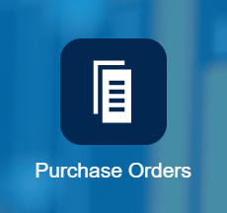
Search for Requisitions and POs
Manage Orders
Log into Aggie Enterprise
Click Procurement, and then click Purchase Orders.
Click Tasks (paper icon) on right side of page.

Slide 10
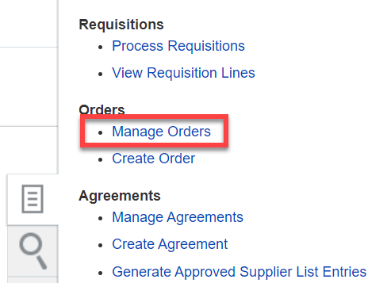
Search for Requisitions and POs
Manage Orders
Click Manage Orders.

Slide 11
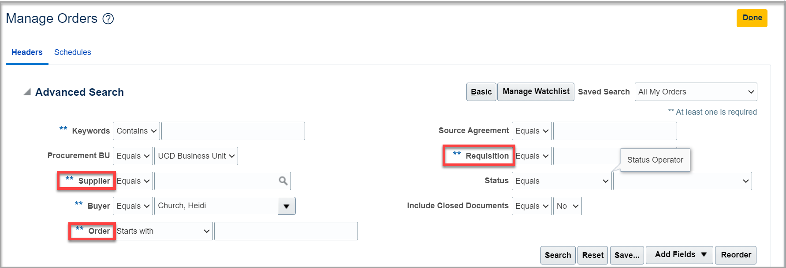
Search for Requisitions and POs
Manage Orders
In the Manage Orders dialog box, click Advanced to select whether to use Starts with, Contains, or Ends with search criteria.
Order is useful if the Purchase Order number is available.
Requisition is useful if the approved Requisition number is known.
Supplier is useful to see all Purchase Orders issued to a specific supplier.

Slide 12
Search for Requisitions and POs
Manage Orders
After you finish setting the search criteria, click Search. The search results appear. In the search results, there are a number of columns that are useful to review key Purchase Order details such as Supplier, Status, and Buyer (name).
Click the Purchase Order number link to view the Purchase Order page and details of the PO, most of which were entered in the Requisition, such as line items, account distribution information, notes and attachments.

Slide 13
Search for Requisitions and POs
Save Searches
If you prefer not having to change the search criteria each time, you can save any desired search criteria ahead of time. After entering your desired search criteria:
Above the Search Results section, click the Save button.
In the Name field, enter a name for the search.
Check the Set as Default box to make the search a default.
Each time you go to the search screen in the future, the search with your desired criteria will now be the default.

