Slide 1
Monterey County Record Book Workshop Workshop #2 -“APRs”
Created by Lockwood 4-H - 2021
Notes:
MC Welcomes everyone, hosted by Lockwood 4-H, introduce our committee members, MC, Attendance, Chat Monitor (will monitor the chat box for any questions – list your name and club, then your question), and Speaker.

Slide 2
Pledges
I pledge allegiance to the Flag of the United States of America and to the Republic for which it stands, one nation, indivisible, with liberty and justice for all."
Notes:
Ask for volunteers to lead the pledges or have someone designated. Ask people to stand up?

Slide 3
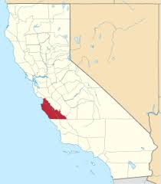
Monterey County encompasses 15 clubs, 800 youths, and approximately 200 adult volunteers:
Aromas
Buena Vista
Carmel Valley
Chualar
Gonzales
Greenfield
Hilltown
King City Rural
King City Blue Ribbon
Lockwood
Mission
Natividad
Royal Oaks
San Benancio
Spring
https//ucanr.edu/sites/uccemontereycounty/files/306813.pdf (ucanr.edu)
Notes:
Quick overview (15 clubs, 800 youths, and approx. 200 adult volunteers), let’s see some action in the Chat as we call out your club names!

Slide 4
Our Team:
LOCKWOOD 4-H
Josh Riley – Committee Chair & MC
Seralyn Colton – Committee Member and Tech Advisor
Lochlan Drinkwine – Chat Monitor
Morgan Hancock – Attendance Keeper
Katie Colton – Adult Chair, Speaker
County Council
Carla Ackerman
Lockwood 4-H Club Leader
Misty Hancock
4-H Program Representative
Lorin Hoffmann-Lurz
Notes:
Introduce yourself, and your team members (have them say a quick hello. Introduce Carla, Misty, and then Lorin (Lorin may want to speak)

Slide 5
So …. what kinds of projects does 4-H offer?
Depends on the Club …
A 4-H project could be ANYTHING You can think of!
If your club doesn’t offer it … maybe another one does!
*(Check with your 4-H Representative)
What Any Project Needs:
Adult Volunteer
To be something 4-H Youth are interested in …
Offer at least 6 hours of instruction (can be virtual or in-person).
Notes:
Before we get started with the APR, lets talk about 4-H projects. What kinds of projects does 4-H offer? Is it all about animals or agriculture? NOT AT ALL! What projects are offered depends on the club and the volunteers. In fact, a 4-H project can be on just about anything you can think of, and if YOUR club doesn’t offer it, maybe another one does! For instance, if you really want to be in a horse project, but your club doesn’t offer that project, check with your 4-H representative (Lorin) to find out if a club near you offers it, and what you need to do to participate.
There are a few things any project NEEDS: It must have an adult volunteer, someone who is willing to teach; it must be something 4-H members are interesting in (if no one joins the project; and it must offer at least 6 hours of instruction – which CAN be virtual or in person. Simple, right?

Slide 6
Now it’s YOUR TURN …
Say your name, your CLUB, and your favorite PROJECT, or one that your club offers …
If you know the Project Leader’s name, give them a shout out!
Let’s see some 4-H PRIDE!

Slide 7
Projects
Archery
Arts and Crafts
Babysitting
Bowling
Civic Engagement
Dairy Cattle
Dance
Dog Care/Training
Entomology
Fashion
Fishing
Floral Arrangements
Goats
Gardening
Hiking
Hippology
Interior Design
Jewelry
Knitting
Leadership
Leathercraft
Livestock Projects
Market Goat
Meteorology
Numismatics
Origami
Photography
Poultry
Quilting
Rabbit
Robotics
Scrapbooking
Service Learning
Sheep
Sports
STEM
Swine
Topiary
Upcycling
Visual Art
Welding
X-ploring
Yoga
Zoology
Notes:
… all of these are or CAN be 4-H projects … from A to Z, the possibilities are endless! See any you’d be interested in? Numismatics is the study or collection of coins, paper money, or related objects. STEM stands for … Science, Technology, Engineering, and Math. I think I’d like to learn about Meteorology! Best of all, the adult volunteer does NOT have to be an expert to teach it … they just have to be willing to learn.

Slide 8
In a 2019-2020 report …
https://ucanr.edu/sites/UC4-H/files/339098.pdf
Notes:
In preparing for this workshop, I came across some statistics that I wanted to share with you! In a recent study, they listed over TWO HUNDRED SEVENTEEN THOUSAND total 4-H projects!

Slide 9
Questions about Projects
Why doesn’t my club have that project available?
Who’s responsible for teaching a project? Who makes the lesson plan?
How can I get my club to offer a specific project?
Can more than one leader teach the project?
What if I’ve already taken that project, why should I take it again?
Notes:
Each club offers the projects that are offered by the Adult Volunteers. If no one is teaching that project, talk to your club leader or your parents (maybe someone else has expressed interest in it also …)
Volunteers – there are some books available in the 4-H Mall for different project, but the bottom line is, it’s up to the instructor. Sometimes a project has been around for a while, and the lesson plans have been handed down from one instructor to another,
Ask! Your club leader, your parents, other 4-H members, even your 4-H Rep. If there is enough interest, you can make it happen!
Yes! Sometimes two leaders will split a project (by age group, or by # of years in the project) or share a project (one does the meeting, the other handles the Fair), etc.
If you liked doing it, you can always take the project again. Often, the leader will provide different content for 2nd year members. You will learn by doing … the more you do, the more you learn. And you can become a junior or teen leader and help teach other members!

Slide 10
Why do some clubs offer different projects?
Projects are taught by VOLUNTEERS, and in order to provide a project for its members, there must be a …Project Leader!
If you have a project you would like to see in your club, talk to your Club Leader, and your Parents (or Guardians).
Parents/Grandparents/Guardians may become Project Leaders if …
Become Certified Adult Volunteers (fingerprinted, background check)
Complete Annual Adult Volunteer training
Become a member (many clubs pay dues for their Adult Volunteers)
Offer a minimum of 6 hours of instruction

Slide 11
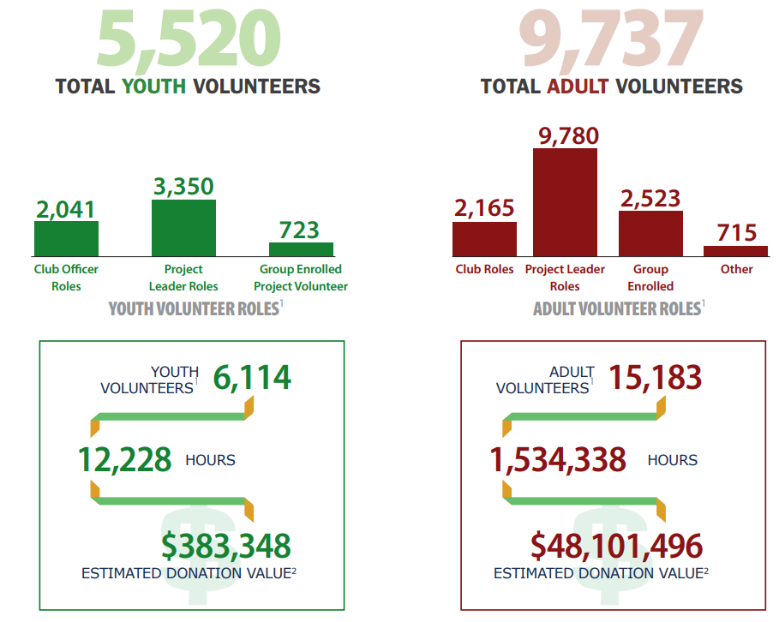
Project Leaders
Teen Leaders
Junior Leaders
Club Officers
Activities or Events
County Council
Youth Council
… We our
VOLUNTEERS
https://extension.umn.edu/about-4-h/4-h-volunteer-impact-study
Notes:
When we talk about volunteers, we don’t just mean the adults. 4-H becomes exactly what you make it. From Project leaders and Junior or Teen leaders to Club Officers – you can see that 5, 520 YOUTH volunteers contributed over 12 thousand hours; and 9,737 Project Leaders and other ADULT volunteers account for over one million five hundred thousand hours, a donation value of over 48 million dollars!

Slide 12
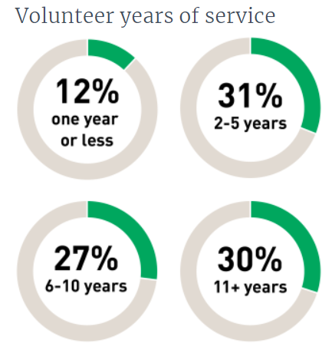
Top reasons to Volunteer …
#1 Support a Child in 4-H
#2 Help Others
#3 To Make A Difference
https://extension.umn.edu/about-4-h/4-h-volunteer-impact-study
Notes:
Why? Why do they do it? The three top reasons …
But stick with me here, because I think THIS is even more impressive. 12 percent of the volunteers in 4-H have served 1 year or less; 31 percent for 2 to 5 years, 27% have been involved for 6 to 10 years, and 30% have continued to serve for more than 11 years! In 4-H, you’ve probably noticed we have lots of opportunities to volunteer. And you are encouraged to step up, from being a youth chair for an activity or event, serving as a junior or teen leader, as a club officer, or in community service … each one of these helps to build strong leaders of tomorrow … that’s YOU!

Slide 13
“HEY 4-H’ers …
How do you feel?!
We feel good!
Oh, we feel SO GOOD!
OH
Double OH OH
Triple Woo woo WOO!
Notes:
SERALYN to handle this break out session. Cheer
Play Simon Says …
INTRODUCE Jessica Riley for next portion (APRs)

Slide 14
SECTION 4: Projects (Annual Project Reports)
One APR for EACH completed project
How many projects can I take?
Ask !
Time Commitment?
Money?
Age Limitations?
Outside of 4-H (school, sports, family, etc.)
One Annual Project Report for each project (per year).
Notes:
* A completed project means you must have attended 80% of Project meetings (a minimum of 6 hours)
If less than 80% attendance, Talk to the Project Leader about make-up opportunities or consider dropping the project before the deadline.
ASK parents, ASK Project Leader if there are age limitations. Consider commitments outside of 4-H (be realistic about your time),
All clubs require you to complete an APR for each project IF you wish to be in the same project next year!

Slide 15
SECTION 4: Projects (Annual Project Reports)
One APR for EACH completed project
How many projects can I take?
Ask !
Time Commitment?
Money?
Age Limitations?
Outside of 4-H (school, sports, family, etc.)
One Annual Project Report for each project (per year).
Notes:
A completed project means you must have attended 80% of Project meetings (a minimum of 6 hours)
– if less than 80% attendance, Talk to the Project Leader about make-up opportunities or consider
dropping the project before the deadline.
ASK parents, ASK Project Leader if there are age limitations
Commitments outside of 4-H (be realistic about your time)

Slide 16
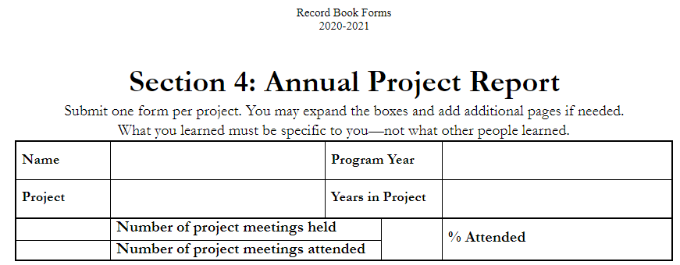
Let’s look at an APR …
Starting at the top
Jimmy Cricket
2020 - 2021
Numismatics
1
8
7
87.5
Example: 7 Meetings ATTENDED ÷ 8 Meetings HELD = .875 … = 87.5 % Attended
Notes:
Section Two of your Record Book is the PDR. Record … report … gives you a place to keep track of your progress. I put the sample entries in red here for emphasis but remember that the 4-H manual gives you the accepted formatting options, including font sizes, ink colors, and margins.

Slide 17
TIPS for Success
Keep track of what you learned.
List Project Meetings, Shows, Clinics, Events, and individual time spent on your project.
List things made, grown, or raised during the year.
Keep track of expenses for your market reports, or just for your own experience. Consider the VALUE of supplies or tools you received (even if they didn’t cost YOU anything).
Keep a record of any awards, prizes or money earned.
What is the project VALUE at the end ( … your project does not have to make a profit), but it does have value!
Notes:
So, when do you think you should start filling out your APR?

Slide 18
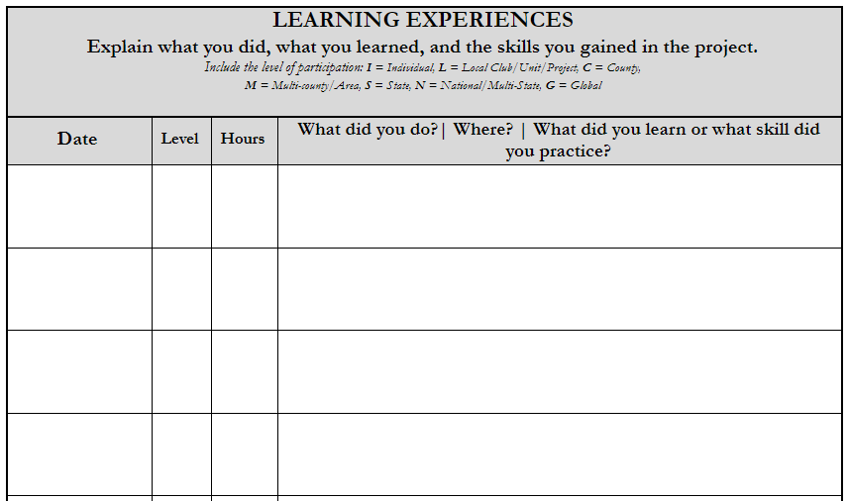
Learning Experiences
Explain …
Date
Level
Hours
What you did
Where?
What did you learn or practice?
Meeting #1: Leader’s House. I learned that Numismatics is the study or collection of currency, including coins and paper money. I learned that coin collecting has been around a long time, and collectors often …
2/1/21 L 1.5
I visited my grandpa, who showed me his coin collection. I learned the history of some of his coins, and that while some are not very valuable, they can be important to the collector for various reasons.
3/5/21 I 1
I attended a seminar on coin collecting online, hosted by the American Numismatic Association, which explained ANA grading standards, and learned that “a cleaned coin is a ruined coin.”
3/6/21 N 2
Notes:
Eight Categories (will go over each one), Total Past Years, Total THIS YEAR, Total ALL Years.
Categories with an asterisk (*); split categories.

Slide 19
APR Page 2
Let’s review this part …
List anything that is related to your project.
1
Poster on Coin Collecting
1st Place, SVF
15
Chinese Coin Collection
3
Numismatics: History of a Coin
Display; Club, School, project mtg.
Notes:
Page 2 of APR

Slide 20
APR Page 2
Let’s review this part …
Anything that is related to your project should go here. Are you a junior or teen leader for this project? Did you do any Leadership development activities related to your project?
Civic engagement – an information booth at the fair, a petting zoo at a local function, or a science project or display to tell people about 4-H and your project animal.
Notes:
Page 2 of APR

Slide 21
Expenses and Income/ Value
These are events or activities where you demonstrate your knowledge to an audience or judge.
You CAN participate in skill activities where you are not enrolled in a corresponding project, as long as the skills are related to a 4-H project.
Supplies
- Things you bought
- Things that were provided for you
Tools and Equipment used
Project Animal (cost)
Transportation
Project Skill Activities Outside of 4-H
You can ADD lines as needed (in Word, go outside the table and press enter. Using Google Docs, right click and select Insert)
Determine which it should be, income or expense. Items that are not used up can have both.
If you use a separate report (Market Animal Report), record book judges still like to see this filled out. You should list the totals, and the profit/loss should match your other report.
Regardless, the numbers here are really for YOU – it’s a learning experience!
Notes:
Expenses and Income or VALUE section …

Slide 22
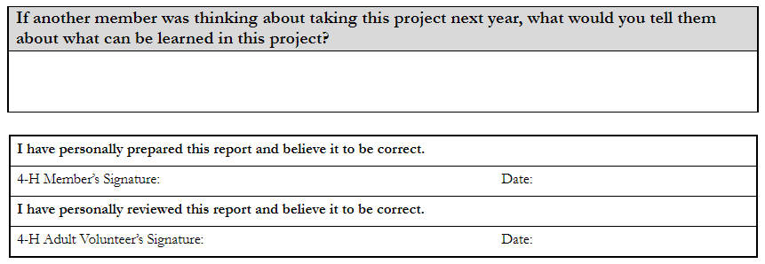
APR Page 2
Let’s review this part …
Notes:
Page 2 of APR

Slide 23
Expressions Page
Be creative
Show what you learned
Draw something
Take a picture and explain it
Make a diagram
Make a list of things you learned NOT to do
Show your SPARK!
Examples:

Slide 24
In a browser on your cell phone, type in www.kahoot.it to play …
Notes:
Sera to share screen to run the game, Josh to announce?

Slide 25
4-H Record Book Resources:
Monterey County 4-H Resources
UCANR
Revised 2020-2021 4-H Record Book Manual
4-H Record Book - Monterey County (ucanr.edu)
PDR Forms
APR Forms
LDR Forms
Summary of Years Form
Cloverbud Report Forms
and various Project Report Forms
State Record Book Competition
State Record Book Competition - University of California 4-H Youth Development Program (ucanr.edu)
Google Doc Record Book Forms
2020-2021 Record Book Manual
4-H Resume Template
The Online Record Book (ORB): As of of July 1, 2020, ORB is no longer being used to complete record books.
Visit the ORB Sunset Support Page for information, timeline, tips, and tools to help you during this transition.
Notes:
Where to find more information. Where to find record book forms, samples, tips, the most current Record Book Manual, and a 4-H Resume Template.

Slide 26
Thank you for joining us!
Be sure to record your Attendance under Category 3: 4-H Events Attended. This is a County Level event (“C”), and the time you spent.
SURVEY: Please fill out and return the exit survey (included in your meeting invite).
Questions? Put them in the chat box, or in the survey. We’ll stay for a few extra minutes – we will be putting together a “Frequently Asked Questions” (FAQ) sheet for the county website.
If you need some one-on-one help beyond what we provided today, speak to your club record book helper, County Rep., or contact me directly!
Notes:
Thank you. Ask attendees to fill out and return survey, any more questions? Contact information

