Slide 1
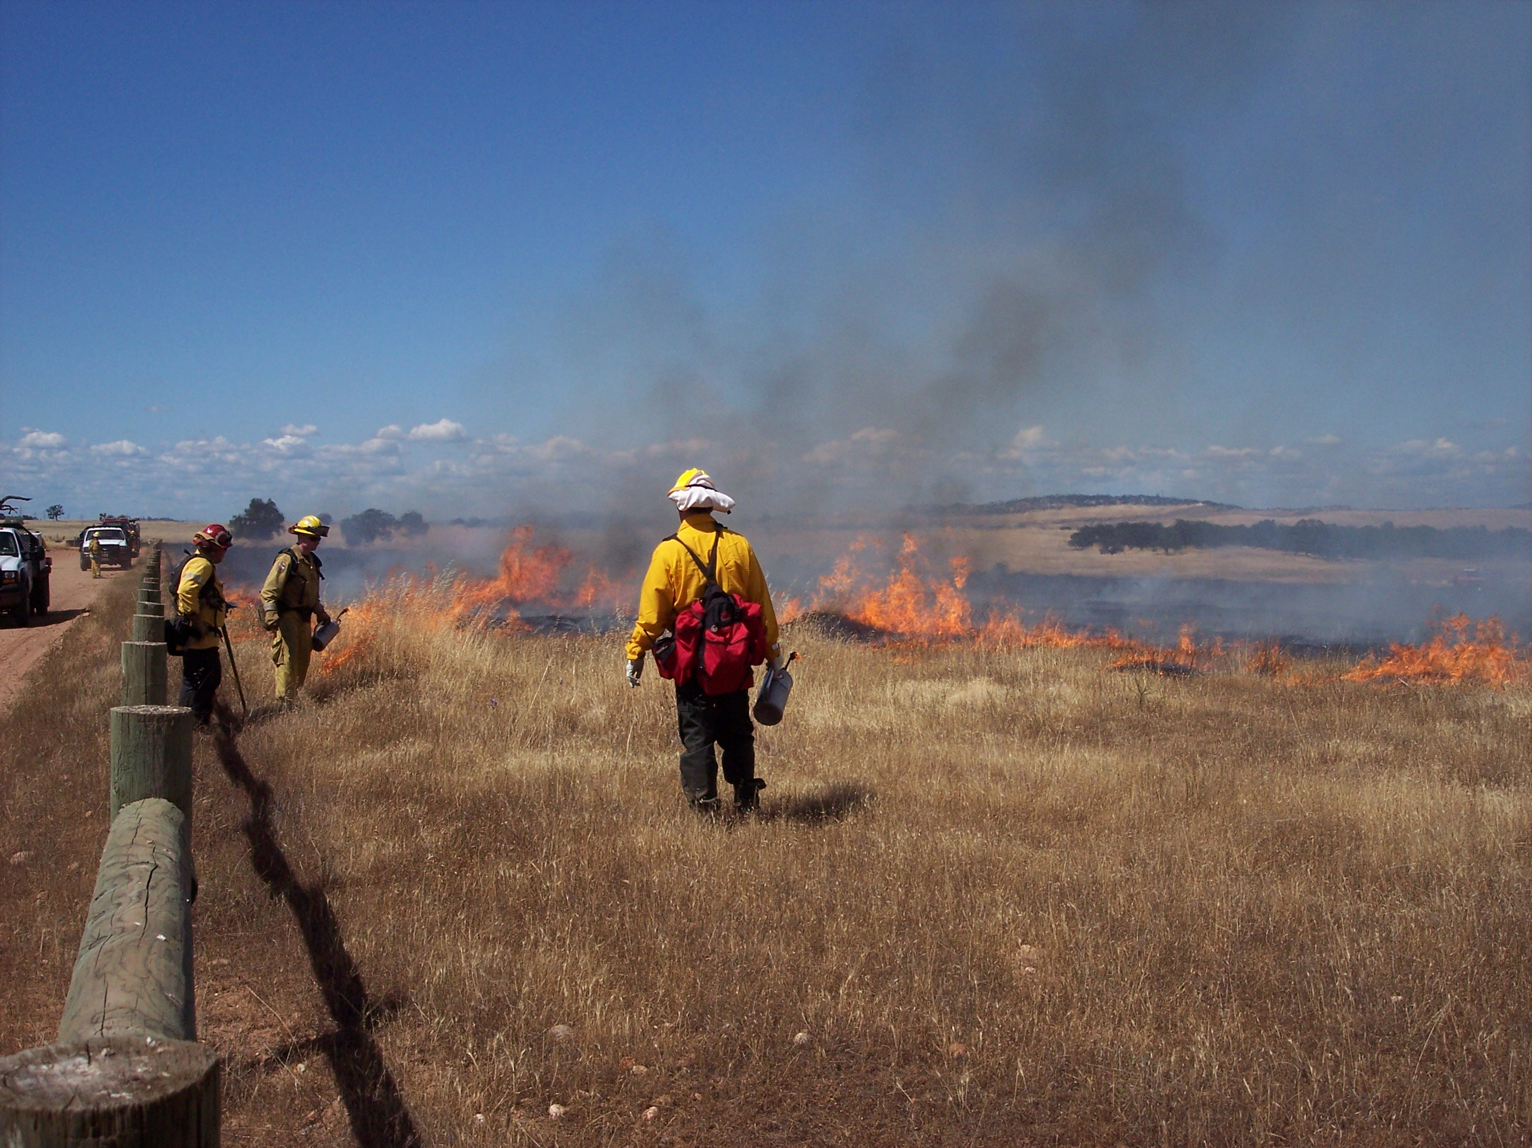
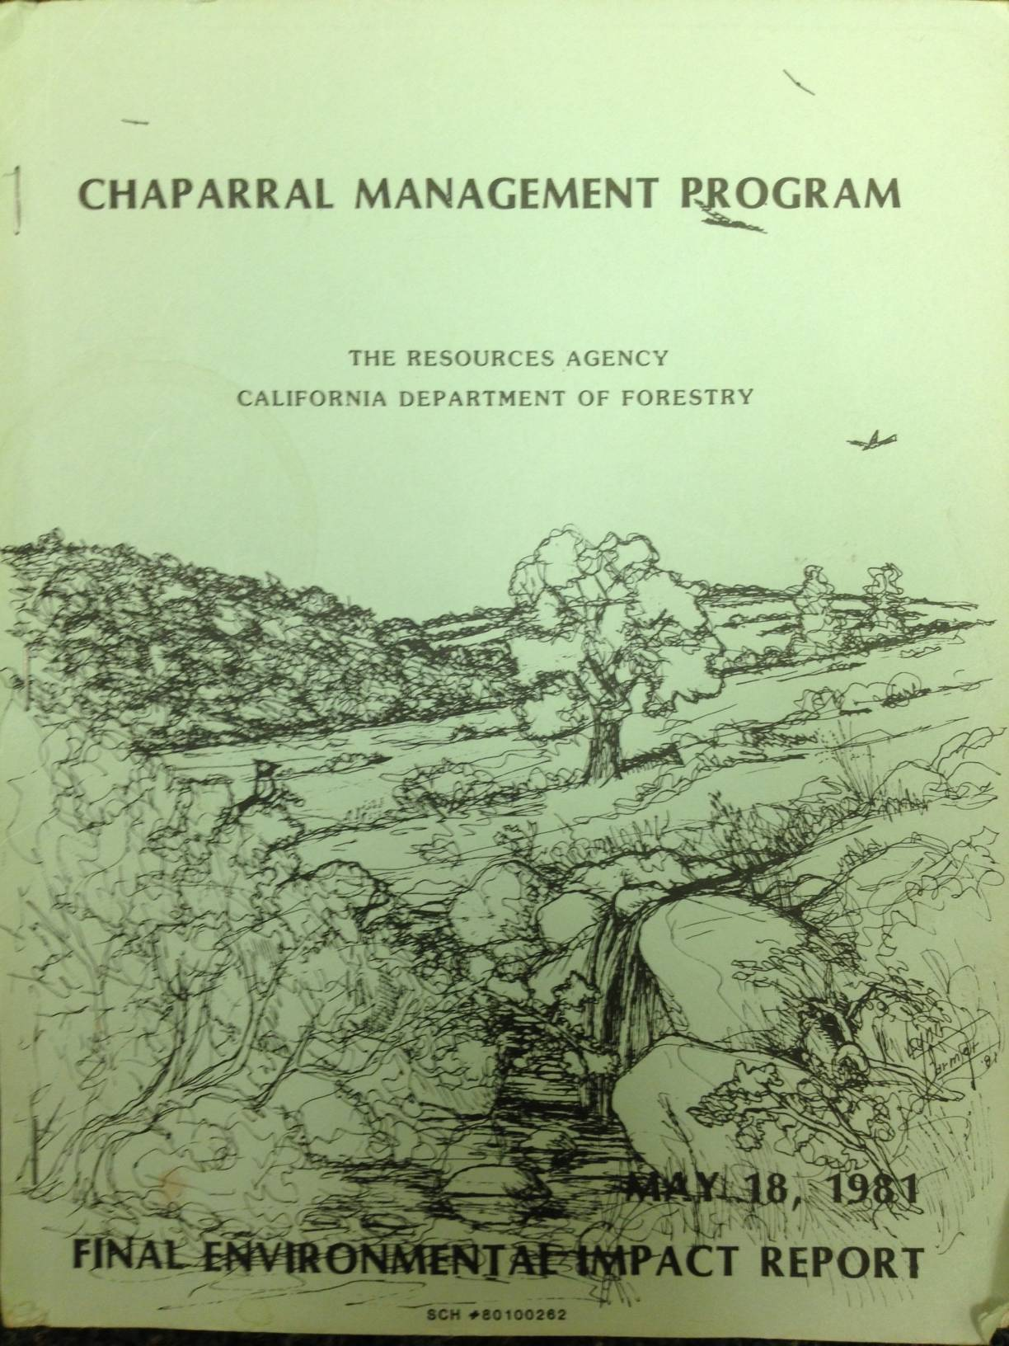
Vegetation Management Program (VMP)
Projects, Processes, Challenges and Permitting
Chris Christopherson
Battalion Chief
Fire Prevention/Law Enforcement
CAL FIRE
Lassen-Modoc-Plumas Unit
Notes:
Good Morning. My Name is Patrick McDaniel. I am a Registered Professional Forester. I started working for CAL FIRE in 2004 as the Unit’s Forestry Assistance Specialist or FAS, administering CAL FIREs Community Assistance Grant and CFIP cost share fuel reduction programs for the Unit.
Since the fall of 2008, I have been the Unit’s VMP coordinator. While the VMP program is going through a lot of changes now, it has been in existence since 1981 and AEU has maintained a very robust VMP program throughout. Today I’ve been asked to discuss AEU’s projects, processes, as well as some of the challenges we’ve experienced.

Slide 2
Content
What is a VMP
Benefits of VMP Projects
VMP Project Development/Notifications
Time Frames for Assessments
CEQA
Permits
Environmental Benefits
Liability
Questions

Slide 3
VMP
The Vegetation Management Program (VMP) is a cost-sharing program that focuses on the use of prescribed fire, and some mechanical means, for addressing wildland fire fuel hazards and other resource management issues on State Responsibility Area (SRA) lands. The use of prescribed fire mimics natural processes, restores fire to its historic role in wildland ecosystems, and provides significant fire hazard reduction benefits that enhance public and firefighter safety.

Slide 4
Benefits of VMP Projects

Slide 5
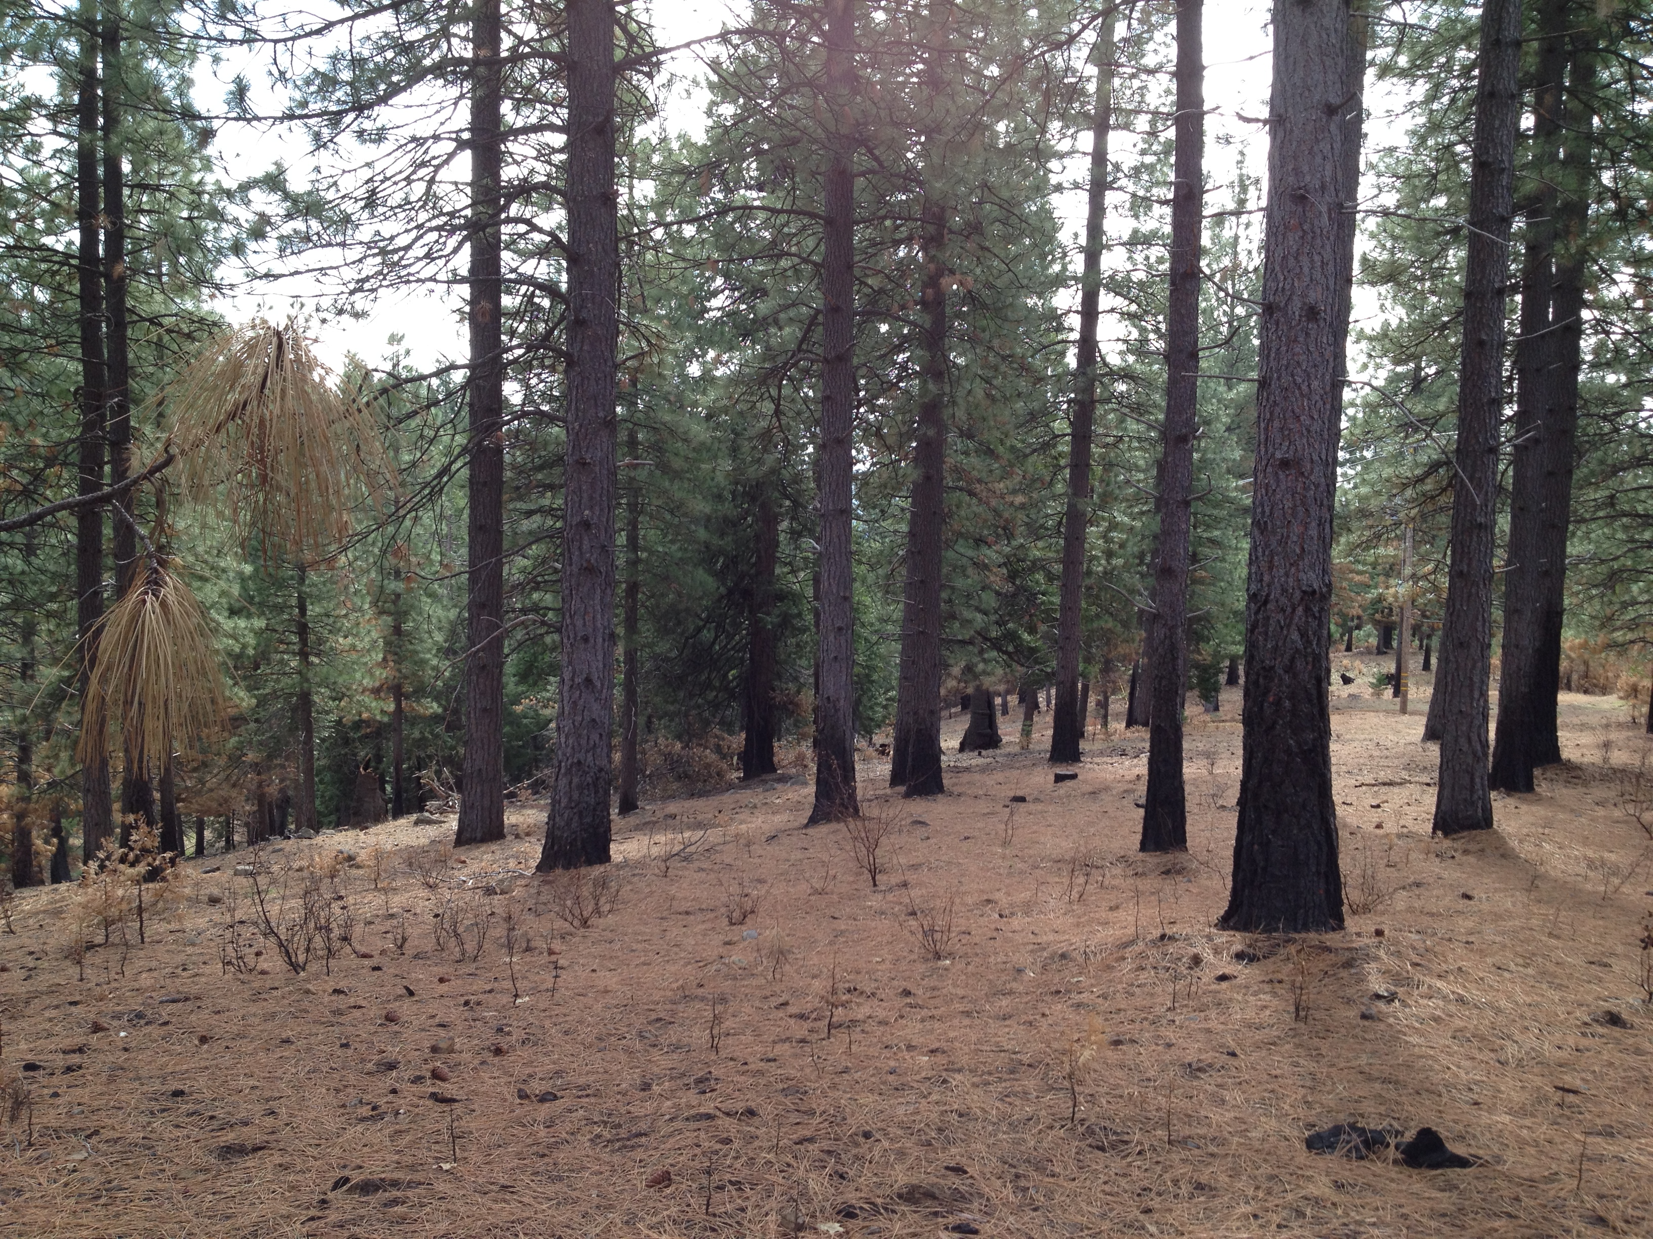
Shaded Fuel Breaks
Notes:
One of the main reasons is to create Defensible Fuel Profile Zones (also known as Shaded Fuel breaks) in strategic locations to protect communities where topography and vegetation support such structures. The objective of these is to provide a defensible location for firefighting operations and evacuations (Such as along a ridgeline, surrounding a subdivision, or along a communities ingress and egress route. Shaded Fuel Break projects consist of inmate crew brush cutting, pruning, thinning, pile burning and using fire crews to administer broadcast prescribed fire.

Slide 6
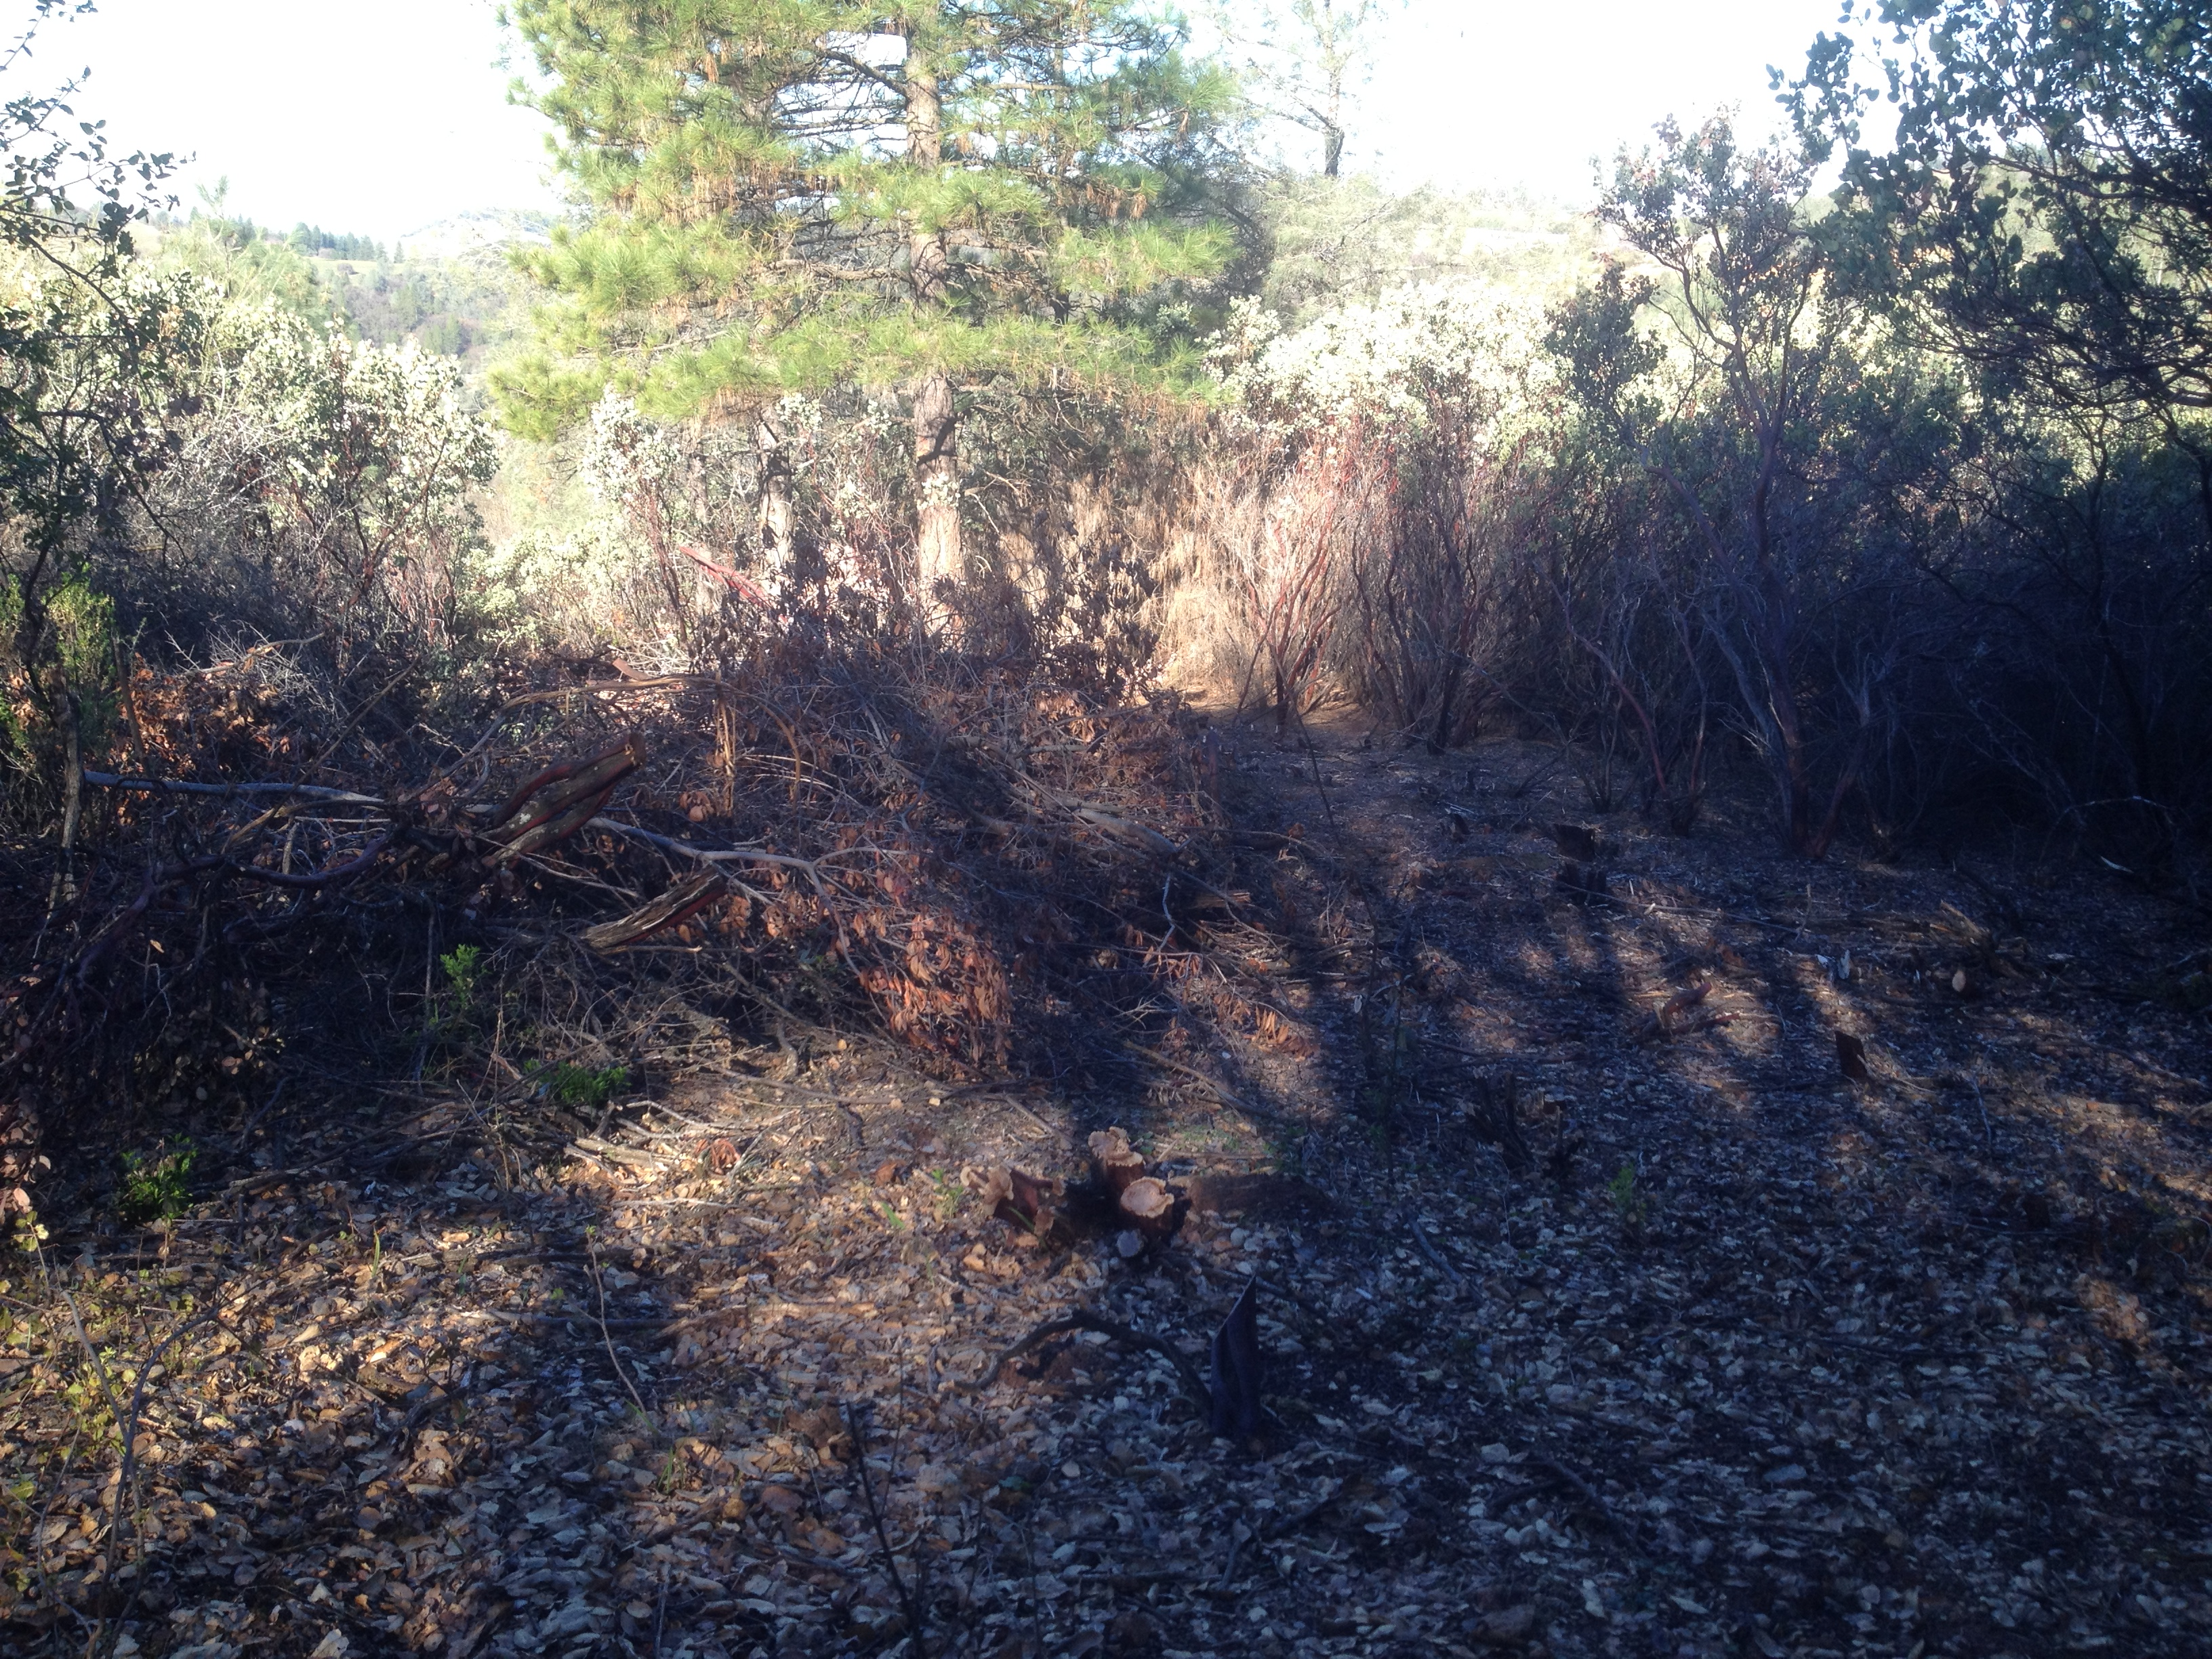
Inmate Hand Crew Spring Preparedness Exercises
Notes:
Another reason we need VMP’s is to give our CAL FIRE inmate crews a place to train in the techniques of hand line construction in preparation for the fire season. We use brush fields to train them during “spring preparedness exercises” We strengthen our relations with cooperators Sac Metro fire, County Fire, adjoining Units, Forest Service, ect.
Piles created always need to get burned as soon as possible.

Slide 7
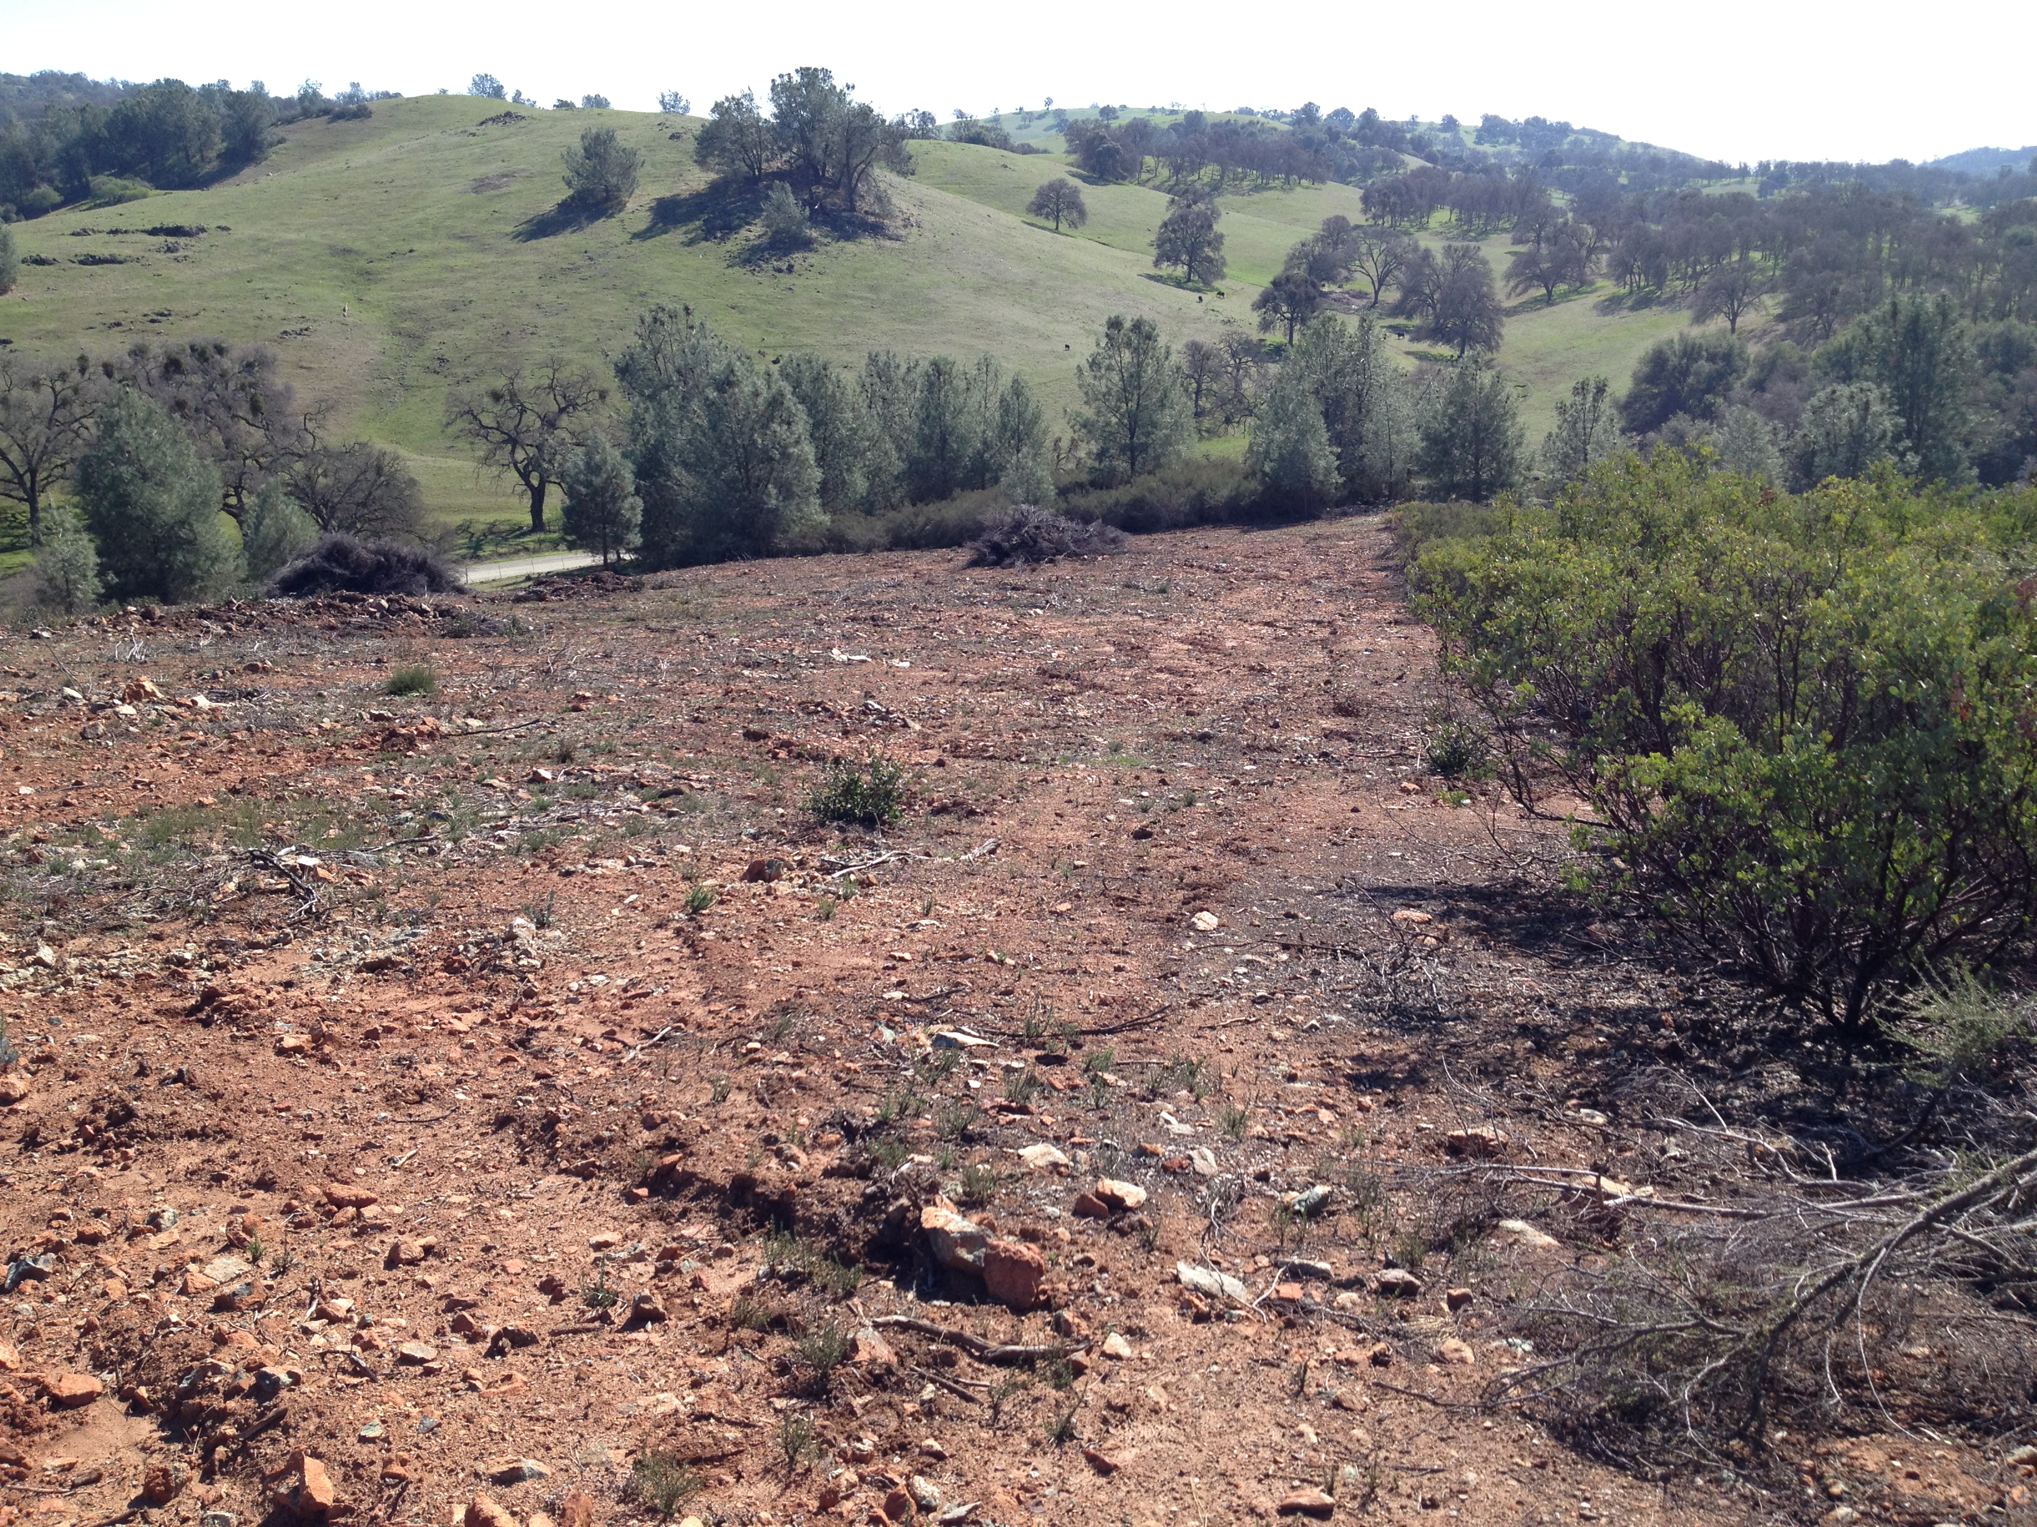
HFEO Training
Notes:
Another reason we need VMP’s is for Heavy Fire Equipment Operators (Bulldozer operators) to have land to train in the practice of clearing brush rapidly on uneven terrain. Often times ranchers are willing to let us clear brush fields on their property. AEU has hosted the Cal Fire Academy's HFEO class in previous years and will do so again this year.
Piles created always need to get burned as soon as possible.

Slide 8
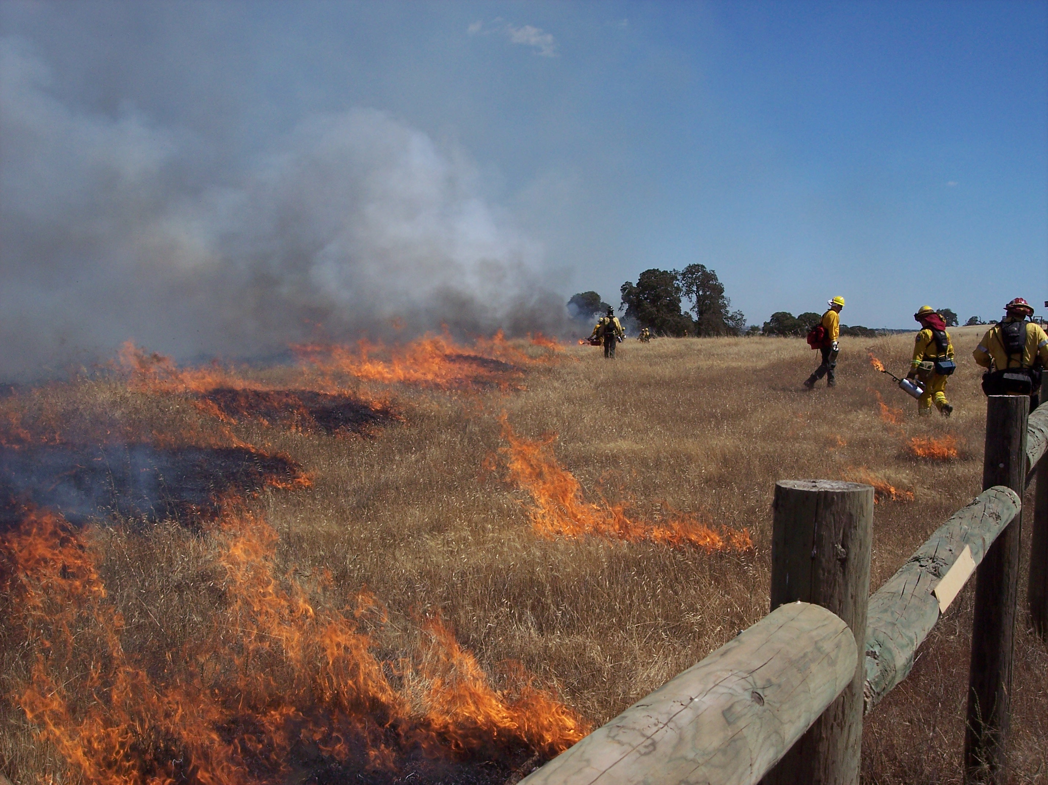
Firefighter Preparedness Exercises
Notes:
AEU undertakes firefighter preparedness exercises in the spring, around May, June and July to train new company officers and firefighters in firing techniques before fire season goes into full swing. Participating landowners include large ranches who would like for us to burn their grasslands to reduce invasive weeds such as Star Thistle and Medusa Head. We have one with a State Park that would like to restore a vernal pool area, and have one with a conservancy who wishes to restore their grasslands and oak woodlands through burning.

Slide 9
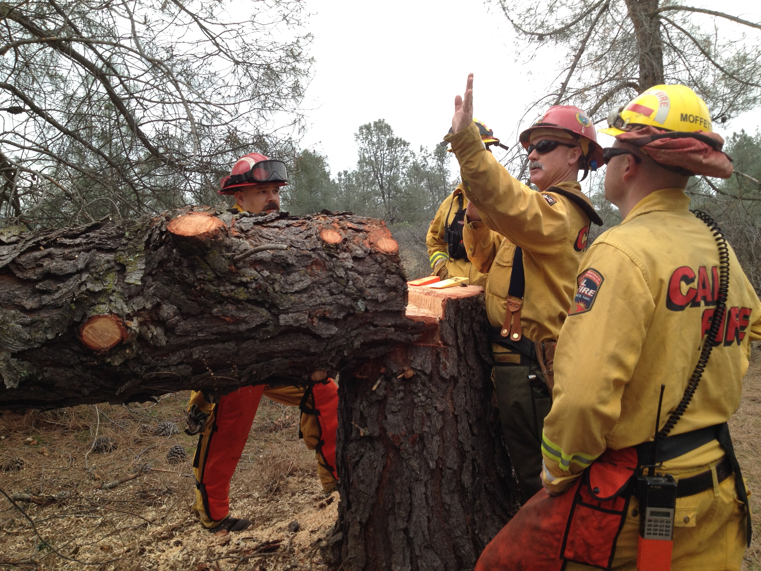
Faller Training and Recertification
Notes:
An important part of wildland firefighting involves falling trees quickly and safely. We need VMP’s to give us places to train and recertify our fallers. Often times, ranchers are willing to allow us to fall Grey Pines on their lands.
Piles created always need to get burned as soon as possible.

Slide 10
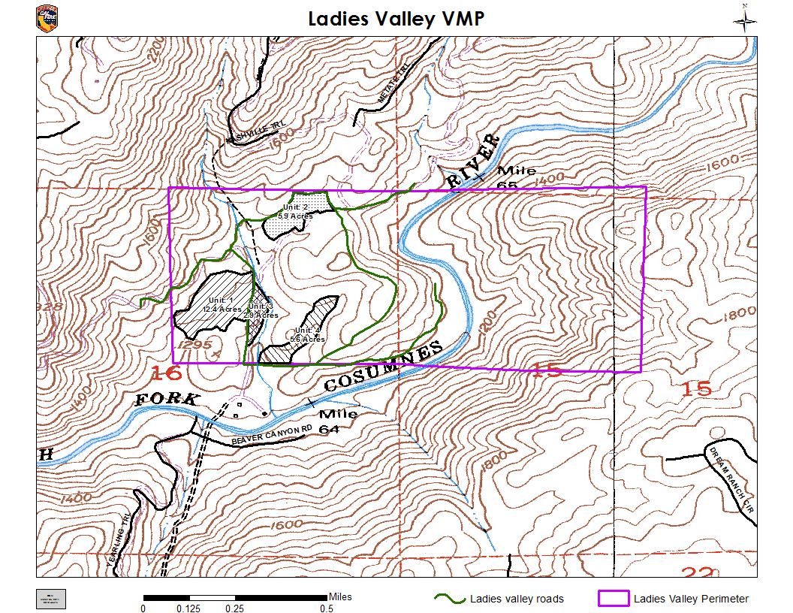
Development Process
New “Fire Plan Framework” is the future.
Project map (topographic)
Create a general location map which shows the project location and which contains major roads and towns in the vicinity.
Create a parcel map with the project boundary mapped on it.
Notes:
Project map (topographic)
Create a general location map which shows the project location and which contains major roads and towns in the vicinity.
Create a parcel map with the project boundary mapped on it.

Slide 11
Project Maps & Scoping
Generate a Natural Diversity Database (NDDB) run, look for any sensitive plant or animal species occurrences within the VMP area or adjacent to it.
Get an archaeological records checks for the entire VMP area. (30 day process)
Send all the Native American groups in the associated area a standard letter notifying them of the project, Include section, township and range. Invite them to share any information they have. Include a project and general location map. (30 day process)
Notes:
Look up what soils are in your project on the NRCS website http://websoilsurvey.nrcs.usda.gov/app/ List the soils in the project area and brief descriptions of the properties of each.
Generate a Natural Diversity Database (NDDB) run, look for any sensitive plant or animal species occurrences within the VMP area or adjacent to it.
Get an archaeological records checks for the entire VMP area from the Information Center in your area. Also check with landowners who may have already done a records check for a THP on their land. Records checks must be less than five years old at the time of VMP submission to region. Have them send the bill to the VMP coordinator in Sacramento.
Work with the Battalion Chief who will be operating the VMP to determine the location of the initial units to be treated

Slide 12
Notifications
Send your local regional water quality control board representative for your area a standard letter describing the project, project map and general location map and ask for any comments they have.
Send the Department of Fish and Wildlife (DFW) biologist for your area a standard letter describing the project with Sections Township and Range, any sensitive species which occur in the project area as per your NDDB run and ask them to schedule a day to visit the project with you. Include copies of your NDDB run, project map, & general location map.
Notes:
Send your local regional water quality control board representative for your area a standard letter describing the project, project map and general location map and ask for any comments they have.
Send the Department of Fish and Wildlife (DFW) biologist for your area a standard letter describing the project with Sections Township and Range, any sensitive species which occur in the project area as per your NDDB run and ask them to schedule a day to visit the project with you. Include copies of your NDDB run, project map, & general location map.

Slide 13
Burn Plan
Write burn plan using the template. Fill in location, acres, environmental conditions, describe what activities you’ll be doing. Go through the burn parameters with the Battalion Chief who will be operating the VMP.
Provide a narrative of each of the soil types in the project area describing the important elements of each.
Names who helped prepare the burn plan specifications will appear along with anyone else who contributed significantly to the plans development.
Notes:
Write burn plan using the template. Fill in location, acres, environmental conditions, describe what activities you’ll be doing. Go through the burn parameters with the Battalion Chief who will be operating the VMP. Work with the VMP’s Battalion Chief and someone who has taken S490 to run a BEHAVE simulation.
Provide a narrative of each of the soil types in the project area describing the important elements of each.
Those peoples names who helped prepare the burn plan specifications will appear along with your name and anyone else who contributed significantly to the plans development.

Slide 14
Cost Summary
Using the VMP instruction book, figure out the public to private benefit ratio and plug those numbers in to the cost spreadsheet. The spreadsheet will then tell you how many dollars worth of “in kind” labor and equipment the cooperating landowner needs to provide.
Work with cooperating landowner to figure out how they are going to come up with that amount of in kind labor and / or equipment time (Be creative). Then fill in Cooperator 1’s page of the spreadsheet and cooperator 2’s page of the spreadsheet, etc.
Notes:
Ask the operations Battalion Chief to help you figure out an estimate how many of each resource he or she anticipates using throughout the three year life of the VMP and how many hours each. This would include seasonal firefighters, engineers, captains, BC’s, engines, pickups, crews, crew busses, dozers, transports, gallons of drip torch fuel, chain saws, and anything else he or she can think of. Fill out the CAL FIRE portion of the cost share spread sheet with these values. If you use a dozer, be sure to include hours of dozer transport and operator as well.
Using the VMP instruction book, figure out the public to private benefit ratio and plug those numbers in to the cost spreadsheet. The spreadsheet will then tell you how many dollars worth of “in kind” labor and equipment the cooperating landowner needs to provide.

Slide 15
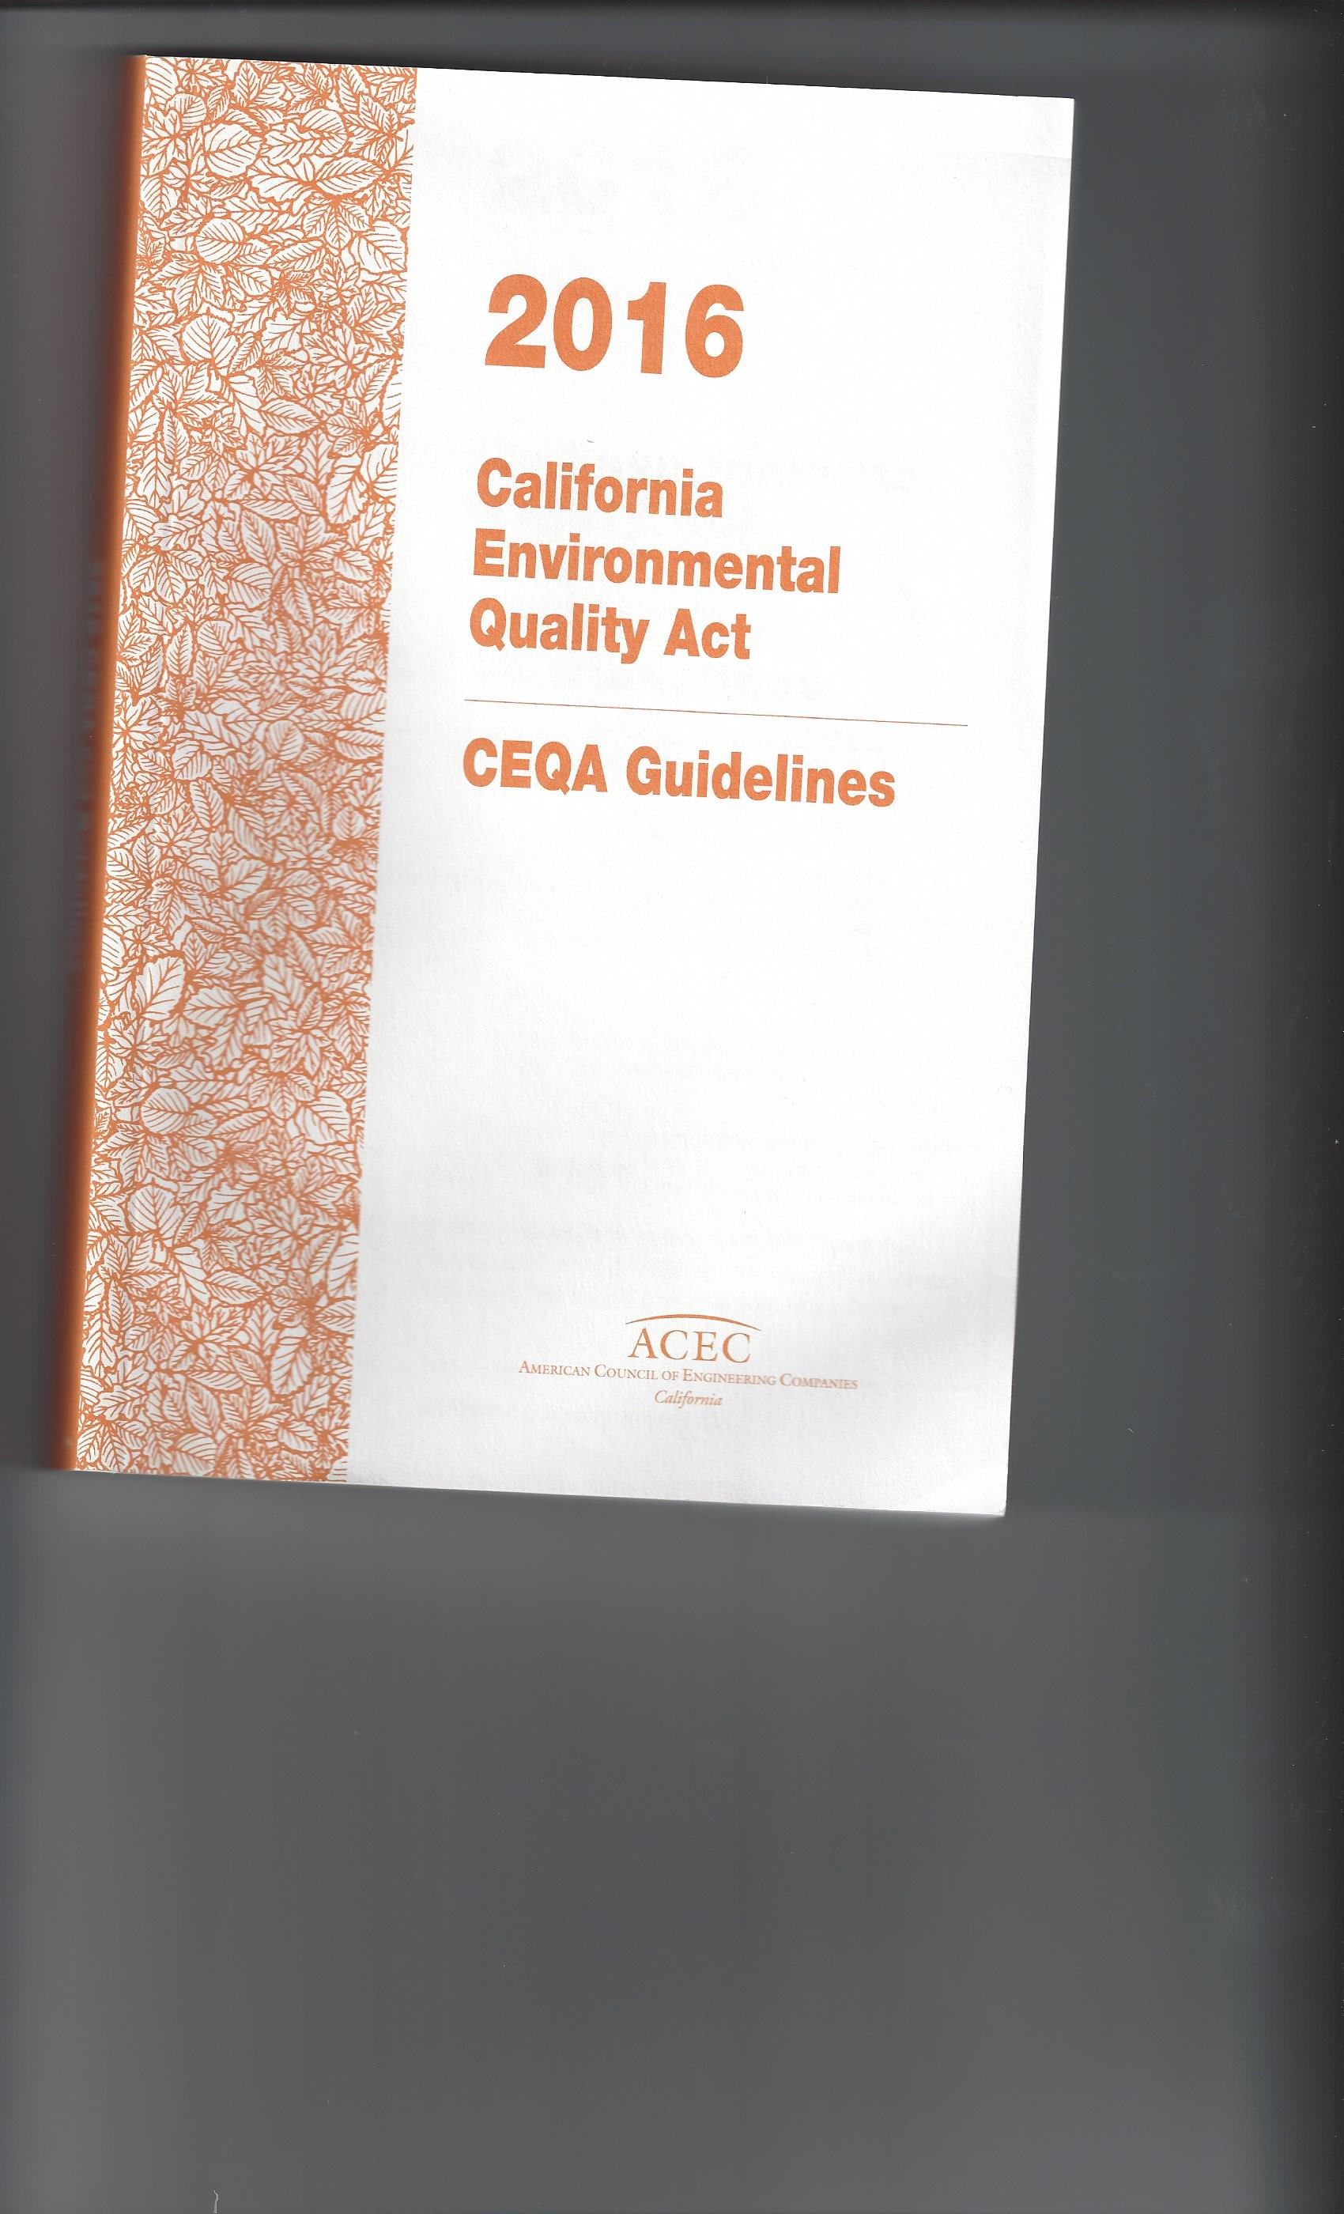
CEQA Compliance
Notes:
CEQA, The California Environmental Quality Act of 1971 applies only to discretionary projects by public agencies. A “project” is defined as a whole of an action which has the potential for resulting in either a direct physical change in the environment or a reasonably foreseeable indirect change in the environment. A “project” under CEQA is considered to be an activity directly undertaken by a public agency, an activity that is supported, in whole or in part, through public agency contracts, grants, subsidies, loans, or other assistance from a public agency, or an activity involving the public agency issuance of a lease, permit, license, certificate, or other entitlement for use by a public agency. An agency is generally not permitted to treat each separate permit or approval under a program, such as the VTP, as a separate project segment, if the effect is to avoid full disclosure of environmental impacts. However, CEQA does encourage the application of a programmatic approach where a group or series of projects are similar in activities and impacts and where potential impacts can be avoided or mitigated in a similar manner.

Slide 16
Negative Declaration
If needed (Currently VMP’s in Timber do), prepare a Categorical Exemption or Negative Declaration and send it to CAL FIRE’s Region & Cc: CAL FIRE’s CEQA coordinator in Sacramento. The document will be posted at the states clearing house for a 30 day public comment period.
When the Negative Declaration’s 30 day public comment period passes, Sacramento will mail you a Notice of Determination (NOD). Put it in the file with the VMP.
Notes:
If needed (Currently VMP’s in Timber do), prepare a Categorical Exemption or Negative Declaration and send it to CAL FIRE’s Region & Cc: CAL FIRE’s CEQA coordinator in Sacramento. The document will be posted at the states clearing house for a 30 day public comment period.
When the Negative Declaration’s 30 day public comment period passes, Sacramento will mail you a Notice of Determination (NOD). Put it in the file with the VMP.

Slide 17
Landowner Contracts
Prepare two sets of RM-75 contracts for each cooperating landowner.
Send the respective sets of contracts to each cooperator for their signature. The contracts have several parts to them and need to include copies of the burn plan and cost summary.
CAL FIRE-719 Agreement for CAL FIRE or representative to work on Private Property
Notes:
Prepare two sets of RM-75 contracts for each cooperating landowner. Label them (Rx [Region North or South] [Unit VMP Number] – [Unit] .[Cooperator number]) for example: for Cooperator 1, Sierra Pacific Industries (Contract Rx North 023 - AEU.01) and Cooperator 2, Pacific Gas & Electric (Contract Rx North 023-AEU.02), etc. (We need two sets of contracts from each cooperator since the state and the cooperator each will need to have a copy of the contracts with both the CAL FIRE deputy director and cooperator’s signatures).
Send the respective sets of contracts to each cooperator for their signature. The contracts have several parts to them and need to include copies of the burn plan and cost summary.

Slide 18
Timeframes
Timeframe for writing a new VMP ranges from 3-4 months perhaps more if archaeological & biological surveys are required. You need a lot of people to get back to you with information, meet with you, sign contracts, arch reports, etc. That takes time as people have busy schedules.
Timeframe for renewing a VMP is about 2 months as you need to send notifications to Indians and give them 30 days to respond, get the new RM 75’s signed.
Notes:
Timeframe for writing a new VMP ranges from 3-4 months perhaps more if archaeological & biological surveys are required. You need a lot of people to get back to you with information, meet with you, sign contracts, arch reports, etc. That takes time as people have busy schedules.
Timeframe for renewing a VMP is about 2 months as you need to send notifications to Indians and give them 30 days to respond, get the new RM 75’s signed.

Slide 19
Air Quality Permit
Coordinate getting an air quality permit prepared with your local Air Quality Management District.
Smoke Management Plans
Notes:
Coordinate getting an air quality permit prepared with your local Air Quality Management District.
Make sure you know the number to call the day before the burn to find out if its going to be a burn day.
Familiarize yourself with how the AQMD daily authorization process works, maybe even meet with someone from their office to build a relationship.
Find out if field variances are a possibility. In El Dorado County, we can often times get variances to burn on no burn days if we can show how our activities are not likely to impact anyone.

Slide 20
Permits
LE-5 Permits – Pile burning or Agricultural burning Intended for Hazard Reduction around Homes 100’ Clearance.
LE-7 Permits – Project type burning permit, Prescribed broadcast burning, require a burn plan and maps
Site inspection (LE-8) may require additional containment prework or fire suppression equipment

Slide 21
Broadcast burning benefits
Fuel reduction
Plant ecology
Insect and disease control
Invasive plant control
Forage improvement
Wildlife habitat improvement
Aesthetic enhancement
Lower costs/acre
Training opportunities

Slide 22
Challenges
Public opinion
Management objectives
May need to “ring” leave trees
May require fuel bed modification
Smoke management
Burn prescription/weather conditions
Resource availability
Region drawdown

Slide 23
VMP Project
Fuel bed modified and trees “ringed”

Slide 24
VMP
During
One day after

Slide 25
One Year After Burn

Slide 26
One Year After Burn
Improved wildlife habitat

Slide 27
Two Years After Burn

Slide 28
Pile Burning Benefits
Burn window is wider
More “surgical” – can remove specific vegetation
Can burn with fewer resources
Can burn in small increments
Piles must have to mineral soil clearing to prevent escape

Slide 29
Liabilities
Under a VMP project property owners are protected from Liability of fire damage and or escape (under CAL FIRE supervision).
Private Property permit holders can be held responsible for allowing fire to escape, burning property of others, and may be charged a Felony for Recklessly Causing a fire.

Slide 30
Questions
Thank you
Additional Information Available on CAL FIRE Website search VMP

