Slide 1
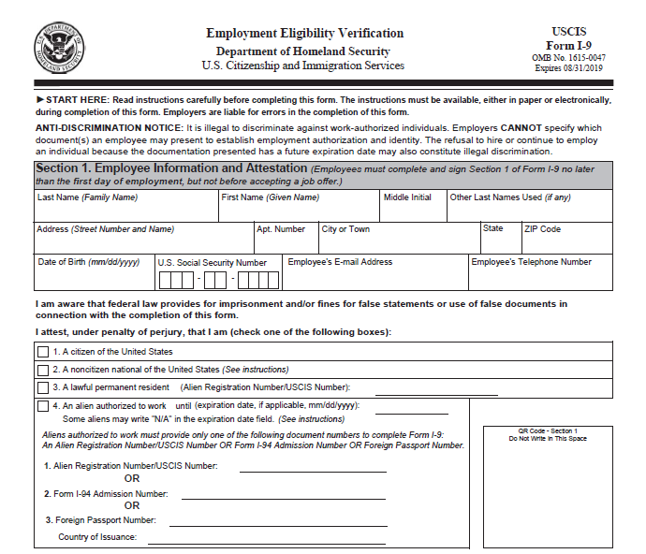
Form I-9 and Tracker System Training

Slide 2
Learning Objectives
I-9 Essentials
Tracker System Highlights
Special I-9 Procedures
I-9 Demos
I-9 Resources

Slide 3
Who needs a Form I-9?
The Form I-9 is only required for employees who perform labor or services in return for actual or anticipated wages or other remuneration.
Employee: A person who performs labor or services in the United States in return for wages or other remuneration
Remuneration: Anything of value an employer gives in exchange for labor or services, such as money, meals, lodging other benefits, but does not include gifts
At UC ANR this includes:
An employee “without salary” (WOS) appointment receiving a stipend
Any unpaid visitors anticipated to receive UC ANR remuneration
Do NOT complete for:
Employees hired prior to Nov. 6, 1986
Individuals not physically working in the U.S.
Volunteers and “without salary” (WOS) appointment employees
Notes:
The U.S. Citizenship and Immigration Services (USCIS) is the government agency that oversees lawful immigration to the United States, and has oversight for the I-9 process. The USCIS states that the Form I-9 is only required for employees.
An employee is a person who performs labor or services in the United States in return for wages or other remuneration.
Remuneration is anything of value an employer gives in exchange for labor or services, such as money, meals, lodging and other benefits, but does not include gifts.
At UC, employees without salary (WOS) should not have to complete the Form I-9. Unless these employees are receiving a stipend or other remuneration. Any unpaid visitors anticipated to receive UC ANR remuneration will need to complete an I-9.
As a reminder, in general, Form I-9s are not required for volunteers or other unpaid individuals.

Slide 4
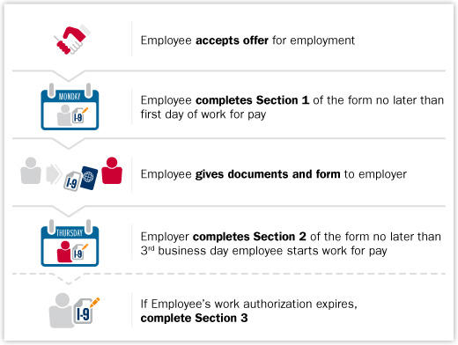
Form I-9 Federal Law Deadlines
4
Notes:
There are very specific federally mandated deadlines for every major step in the Form I-9 process.
The form I-9 process can only begin once the employee has accepted the job offer.
The new employee completes Section 1 anytime after accepting the job, but no later than the end of their first day of work for pay.
The employee then provides the employer (I-9 processor) with their documents that provide proof of identity and work authorization.
The employer (I-9 processor) examines the documents and fills out Section 2 no later than 3 business days from the employee's first day of work for pay.
For new employees, the form I-9 is complete once the employer (I-9 processor) has completed, signed, and dated Section 2.
If the employee's work authorization documents expire, then a reverification using Section 3 must be completed no later than the day the original documents expire.
Before moving forward, let's review the completion timeline for the Form I-9 in more detail.
No later than 3 business days after the employee's first day for pay, the Federal Government requires that:
The employee present documentation to employer
The employer completes and signs Section 2
For example, if your employee began work for pay on Monday, Section 1 is due by the end of the business day on Monday, and you must complete Section 2 by Thursday of that week.
If the job lasts less than three days, you must complete Section 2 no later than the first day of work for pay.
At UC ANR:
It is the processor's responsibility to follow-up with employee regarding work authorization documentation deadlines to complete the I-9 on time and remain in compliance
If the employee does not provide documentation within the required deadline, UC ANR is required to terminate the employee. You must communicate this with the hiring manager or refer to your HR Consultant.

Slide 5
I-9 Violations & Penalties
Employers who knowingly violate or circumvent the Form I-9 process or anti-discrimination requirements of the INA may be subject to
civil and/or criminal penalties.
5
Notes:
Employers who knowingly violate or circumvent the Form I-9 process or anti-discrimination requirements of the Immigration and Nationality Act (INA) may be subject to civil and/or criminal penalties.
It is your processor role responsibility to ensure that the form is filled out correctly and completed by the federally mandated deadlines.

Slide 6
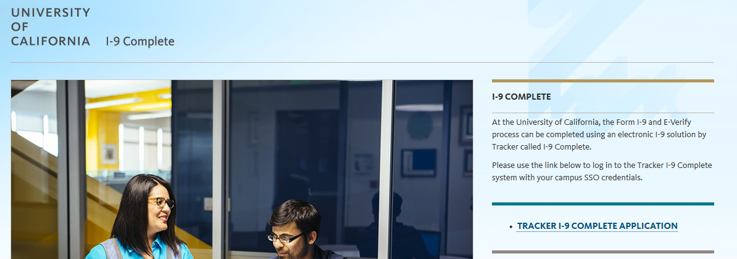
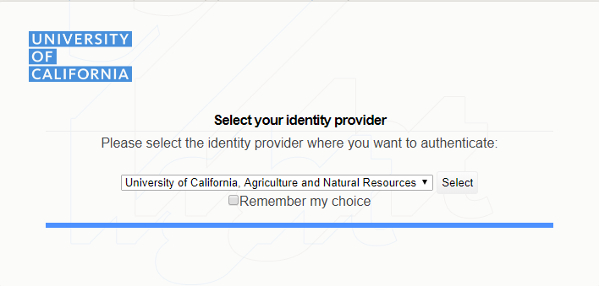
Accessing Tracker At UC ANR
https://i9complete.ucop.edu/
Notes:
It can be accessed by going to https://i9complete.ucop.edu/
Log in using your ANR SSO

Slide 7
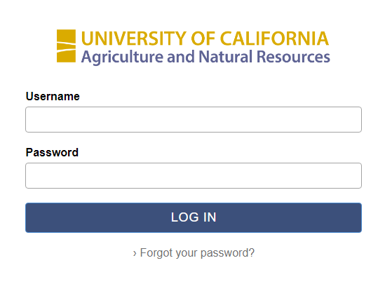
Accessing Tracker At UC ANR

Slide 8
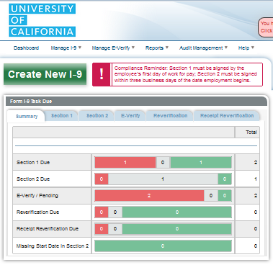
Dashboard overview: Tasks Due
Tasks Due =
I-9 records with an
action due
Color codes:
Red=critical
Grey=warning
Green=not yet urgent
Notes:
Let’s take a look at your new dashboard.
This widget highlights the number of I-9 Records with next actions due with different colors representing urgency.
The urgency is based on when the task is due and will differ depending on the task.
Red = critical
Grey = warning
Green =not yet urgent
The bars are clickable hyperlinks to review the list of records (summary) and take action.

Slide 9
Dashboard overview: Search
Click on the search bar at the top right to bring up the
Search for Existing Employee window
Notes:
The Search for Existing Employee window can be accessed from most Tracker I‐9 pages by clicking on
the search bar in the upper right‐hand corner.
In the Search for Existing Employee window you may locate I‐9 Records via a number of search criteria:
• Last Name
• Employee ID (UCPath ID)
• Social Security Number
• I‐9 ID
You may further narrow your search with additional optional criteria:
• First Name
• Middle Initial
• Worksite
• Date of Birth

Slide 10
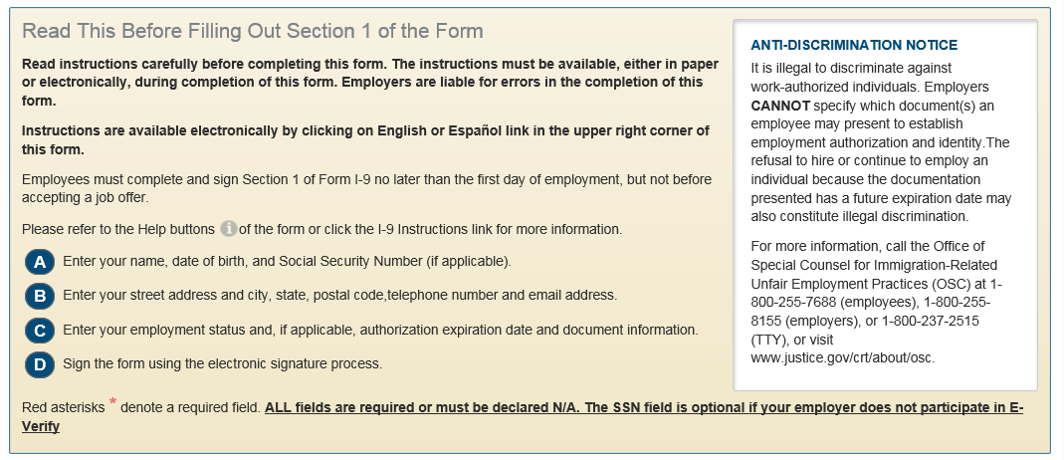
Section 1, Completed by Employee
Notes:
We will be doing a demo of a form, but I wanted to highlight some features surrounding Section 1. Since there are some notable differences than how this was done in Guardian.
Instructions: The system reminds the employee to read the USCIS form instructions which are available to them in English and in Spanish. It also provides them with a note on the required fields that need to have “N/A” written in if they are not applicable. It also mentions how the SSN field is optional (and it is since we are not an all-E-verify required employer).
Helper Bubbles: As the instructions mention there are Help buttons (the grey little “I”). If you hover over them, they have more information for each of the fields.

Slide 11
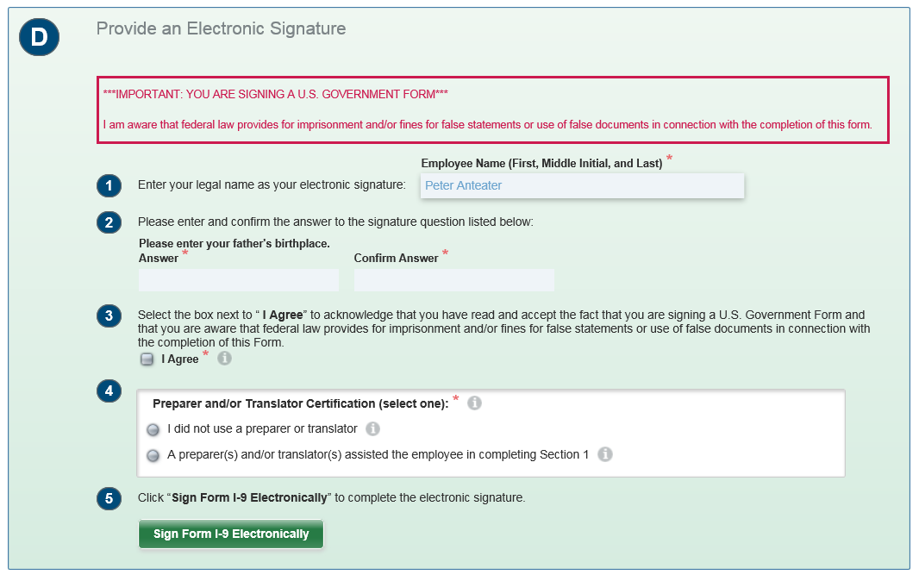
Section 1 highlights
Notes:
Let’s take a closer look at the Electronic Signature
Electronic Signature:
It requires the employee’s full legal name
Then it asks them to answer a signature question and confirm the answer. This is an additional level of “security” and the question will be asked again if the employee needs to sign Section 1 again in the case of edits/corrections
They then have to check a box for the attestation
Preparer or Translator certification: They need to indicate if they needed assistance in completing the form. If they indicate that they did receive assistance, it will ask them how many people assisted and the certification will appear for each assistant to fill out and sign.
Last, the employee clicks on the green Sign Form I-9 Electronically button
REMINDER, EVEN IF YOU ARE THE PREPARER/TRANSLATOR, YOU CANNOT ENTER THIS INFORMATION IN FOR THE EMPLOYEE
In Tracker, Employee's signature consists of:
Answering a security question
Checking 3 boxes
Clicking 1 button
Once Section 1 is completed there is no email confirmation. They can get back to the confirmation page with the link that was sent to them but it expires after 3 days. They can only print the Form I-9 Receipt once (and it is not really a receipt but the actual form).
Reminder: You should only begin the I-9 process after the job offer has been accepted.

Slide 12
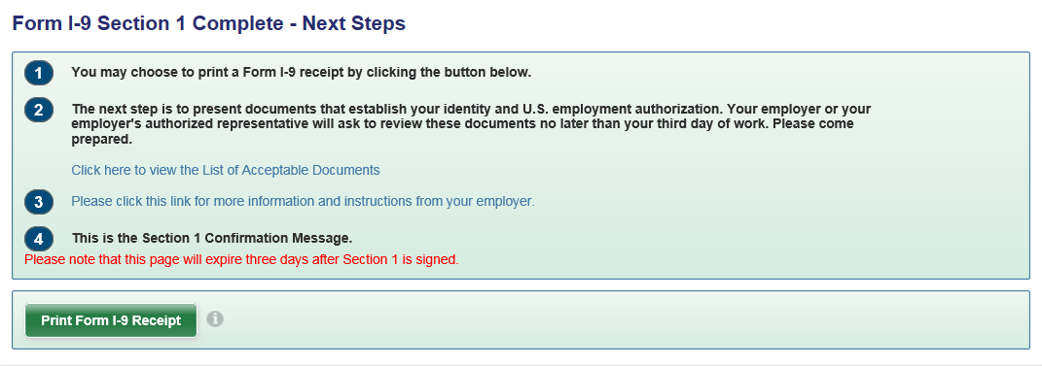
Section 1 highlights
Confirmation Page
Form I-9 Receipt: Not really a receipt, but a pdf of the form! Can only be printed once
List of Acceptable Documents: Link to the USCIS List (not a customized list)
No email confirmation!
Notes:
Confirmation Page
Once Section 1 is completed and signed, the employee is taken to the confirmation page.
They are given the option to print the Form I-9 by clicking the green “Print Form I-9 Receipt” button. Important to note, that it is not really a receipt but the actual form. They can only print the Form I-9 “Receipt” once as well.
It reminds them of the documentation requirement and provides them with a link to their hosted page of the List of Acceptable Documents. Note: This is not a customized list of acceptable documents, rather a pdf of the list that comes with the USCIS I-9 instructions.
#3 is still TBD. Currently, OP is considering hosting a redirect page that will list all of the UC locations to direct the employee to the right HR page.

Slide 13
Section 2, Completed by Location
Notes:
Let’s look at some Section 2 features you should be aware of
View Section 1 Employee information link allows you to view the information that was entered by the employee in Section 1
Helper Bubbles: Similar to Section 1 you have helper bubbles to that you can hover over. These will give you tips on what is expected in the field. /a auto fill
Save/Validate button: This button floats down the as you progress through the screen. IT DOES NOT SAVE YOUR PROGRESS. It only serves to validate the information, but if you try to save it to come back to it, the data will not be there.

Slide 14
Section 2 highlights
Notes:
Although we will be doing a demo, I want to take a moment to look at the list of acceptable documents that you have access to
This is the popup window that appears when you click on any of the dropdowns to select documents while completing Section 2. In this case the employee is listed as a citizen of the United States (according to Section 1) and the available set of documents includes only legally acceptable documents that a citizen of the United States can present.
If you were to click on any of the other documents, a pop-up warning would tell you that this document is not applicable to the citizenship status indicated prompting you to double-check the information that was entered in Section 1. (I know this happens a lot with some employees that select noncitizen national, but present a foreign passport with and I-94 and a DS2019 or and I-20).
When a document is selected, a full Description will appear to the right along with Samples and Doc. #Locator and E‐Verify Info tabs. Once you have selected the appropriate List A or List B and List C documents, click Continue with Selected Document(s) button to continue.

Slide 15
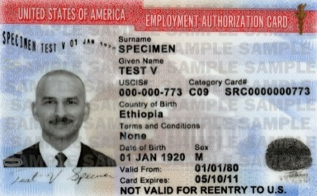
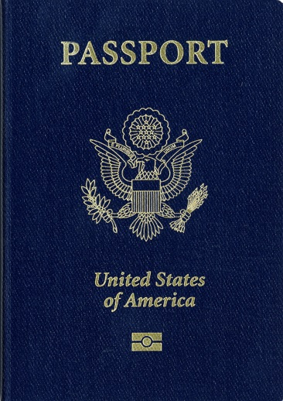
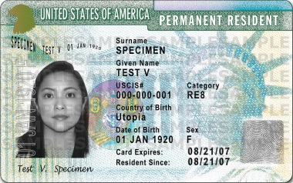
Examining documents
Processors must accept a document presented by an employee if it reasonably appears to be genuine and relates to the individual presenting it.
The document(s) must be original & unexpired
Unacceptable types of documents:
Photocopies
Digital copies or images
Those presented over a screen (ex. Skype)
If an employee presents documents that do not appear to be genuine OR do not relate to the employee, processors must notify the employee
“I’m not able to accept this document as it does not appear to be genuine OR it does not seem to relate to you. Do you have any other documents you would like present from the List of Acceptable Documents?”
Notes:
In order to complete Section 2, processors must examine the documentation the employee presents. Processors must accept documents that reasonably appear to be both genuine and relate to the person presenting them.
It is important to note that you are not required to be a document expert
The document must be the original and unexpired
Document genuineness can only be ascertained by touching the physical copy of the documents
Unacceptable types of documents include:
Photocopies (the only exception is a certified copy of a birth certificate)
Digital copies or images
Or those presented over a screen (i.e., via FaceTime or Skype)
If you determine the document does not reasonably appear to be genuine or relate to your employee, you should allow your employee to present other documentation from the List of Acceptable Documents.
Processors are recommended to use this statement to notify the employee, “I'm not able to accept this document as it does not appear to be genuine OR it does not seem to relate to you. Do you have any other documents you would like present from the List of Acceptable Documentation?”
Should you need further guidance, you are advised to contact your Human Resources Contact

Slide 16
The Receipt Rule
Receipts may be used as temporary proof of employment eligibility when a List A, B, or C document has been lost, stolen, or destroyed.
The “receipt rule” is designed to cover situations in which an employee is authorized to work at the time of initial hire or reverification, but he or she is not in possession of a document listed on the Lists of Acceptable Documents
Receipts must be issued by the originating agency
The employee must present a replacement document within 90 days of the hire date
You cannot accept a receipt if:
It’s for the application for an initial or renewal employment authorization document
If employment will last less than 3 business days
University of California, Irvine Human Resources Department
Notes:
Sometimes, your employee will present a "receipt" in lieu of a List A, List B, or List C document.
Receipts may be used as temporary proof of employment eligibility when a List A, B, or C document has been lost, stolen, or destroyed.
The “receipt rule” is designed to cover situations in which an employee is authorized to work at the time of initial hire or reverification, but he or she is not in possession of a document listed on the Lists of Acceptable Documents accompanying Form I-9.
Receipts must be issued by the originating agency.
The employee must present a replacement document within 90 days of the hire date.
You cannot accept a receipt if:
It's for the application for an initial or renewal employment authorization document or
If employment will last less than 3 business days

Slide 17
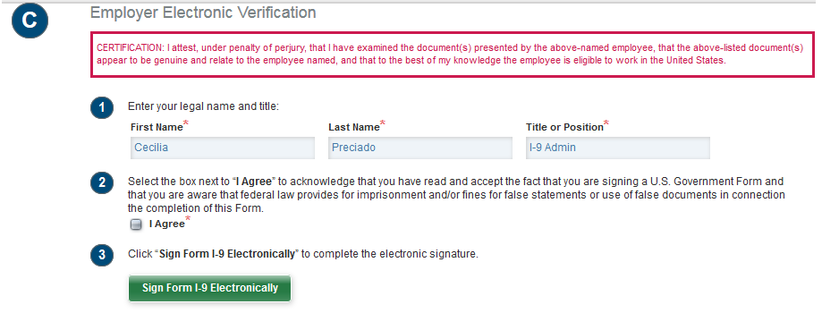
Section 2 highlights
Employer Electronic Signature
Read Certification
Confirm Information
Check the box
Click on the green button
Notes:
To sign Section 2 the I‐9 Manager is required to:
1. Read the Certification text
2. The Enter your legal name and title. The textbox will already contain the full name of the logged in I‐9
Manager User and cannot be edited.
3. The Title or Position textbox will already contain the title of the logged in I‐9 Manager and cannot
be edited.
4. Click the I Agree checkbox.
5. Click the green Sign Form I‐9 Electronically button to complete the electronic signature of Section 2.

Slide 18
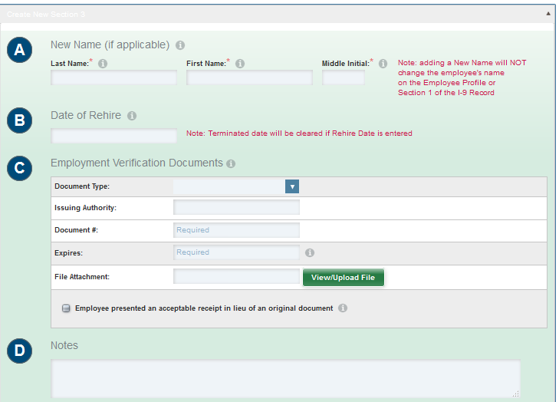
Section 3 highlights
Reverifications & Rehires
Tracker will email Reverification notices to processors before employment documentation expires.
It is recommended you remind the employee of the upcoming expiration date.
Upload the image(s) of the documentation presented into Tracker
Notes:
You can also check the status of upcoming reverifications on your Dashboard under “Top Pending Re-verifications.”
Tracker will send an email to processors and employee. Processors can access this information on the dashboard as well

Slide 19
Amendments
If a mistake is made when the I-9 has been completed, it can be modified or corrected
Types of Amendments
Section 1 Amendments
Corrections for errors that occur in the employee’s section
Must always be approved/resigned by employee
Section 2 & 3 Amendments
Corrections for errors created by the processor
All amendments are included in the I-9 audit trail
Can only be done in person
Notes:
If a mistake is made when the I-9 has been completed, it can be modified or corrected by using the “Amendments” function.
Corrections include striking information, striking and replacing information, as well as adding missing information.
Section 1 amendments address errors that have occurred in Section 1. These must always be approved by the employee. This can be done remotely. Only Section 1 Remote Amendment
Section 2 amendments must always be approved by your HR Group Coordinator.
Reminder: Processor should never delete any type of record created in Tracker.
Video: https://wwwcdn.i9complete.com/media/faq_change_start_date/

Slide 20
Transfers from another UC
When an employee comes to UC ANR from another UC location, their I-9 should follow them
If the I-9 is in Tracker:
The assigned HR Generalist must be notified to initiate the transfer with the UC Systemwide Administrator
If the I-9 is not in Tracker:
Work with the other location to ensure that the existing I-9 will be transferred over
Once received, input and upload into Tracker (shred original if necessary)
If the original I-9 is not located/transferred within a reasonable amount of time, a new I-9 must be created
Notes:
When an employee comes to UC ANR from another UC location, their I-9 should be transferred to the destination UC ANR department. It is the destination department's responsibility to ensure that the I-9 record is received.
The assigned HR Generalist must be notified to initiate the transfer with the UC Systemwide Administrator (Alisa Hsiu)
If the I-9 is not in Tracker, the department must work with the Transfer Coordinator from the other location to ensure that the paper I-9 will be accompanying the new UC ANR employee. Once the processor receives the paper I-9, it must be inputted and scanned into Tracker and the paper copy must be shredded.
If the original paper I-9 is not found, a new I-9 must be created. This is especially important to remember when the employee has had a break in service and their I-9 must be completed 3 days after their first day of work for pay at UC ANR. IT IS MORE CRITICAL TO MEET THE DEADLINES THAT IT IS TO HAVE THE EMPLOYEE’S PREVIOUS RECORD.
Reminder, if there has been a break in service, the employee is considered a rehire.

Slide 21
Steps for New I-9
General Overview
Tracker automatically sends email with secure link to employee
Employee fills out Section 1 prior to coming into the office
Processor reviews documents and completes Section 2
HR Operations reviews documents and validates the information from I-9 Tracker
You should only begin the I-9 Process after the job offer has been accepted
Reminder:
Notes:
Here is a quick overview of the Steps for creating a New I-9.
Tracker automatically sends ONE email with secure link
Employee fills out Section 1 prior to coming into the office
Processor marks complete and approved
HR Ops reviews and validates
Reminder: You should only begin the I-9 process after the job offer has been accepted. Timeline

Slide 22
Resources
Email Contact:
UC ANR I-9 Administrator at humanresources@ucanr.edu
Websites:
UC ANR I-9 Website: https://wwwe.i9complete.com/home
USCIS I-9 Central website: https://www.uscis.gov/i-9-central/handbook-employers-m-274
Manuals & Quick Guides
Tracker Tutorials available in Tracker Dashboard
Notes:
There are many resources that may assist you in further understanding the I-9 legal requirements and UC and UC ANR procedures.
It is recommended that you first contact the UC ANR I-9 Administrator for any procedural questions at humanresources@ucanr.edu.
USCIS I-9 Central is a great resource for VISA/Document-related questions
Manuals & quick guides
Tracker has great resources and an online user manual with video links
I will also be publishing quick guides onto the I-9 HR web page that will cover basics like how to create a new I-9 to creating an I-9 for a Remote Hire, Making Corrections,
How To's:
Complete a I-9 including Section 3
If the employee is there
In advance
Remote I-9
Upload a paper version
Request an employee transfer from one worksite to another
How to make Amendments
Supplementals
Courtesy email sample

Slide 23
Questions?

