Slide 1
4H Camp

Slide 2
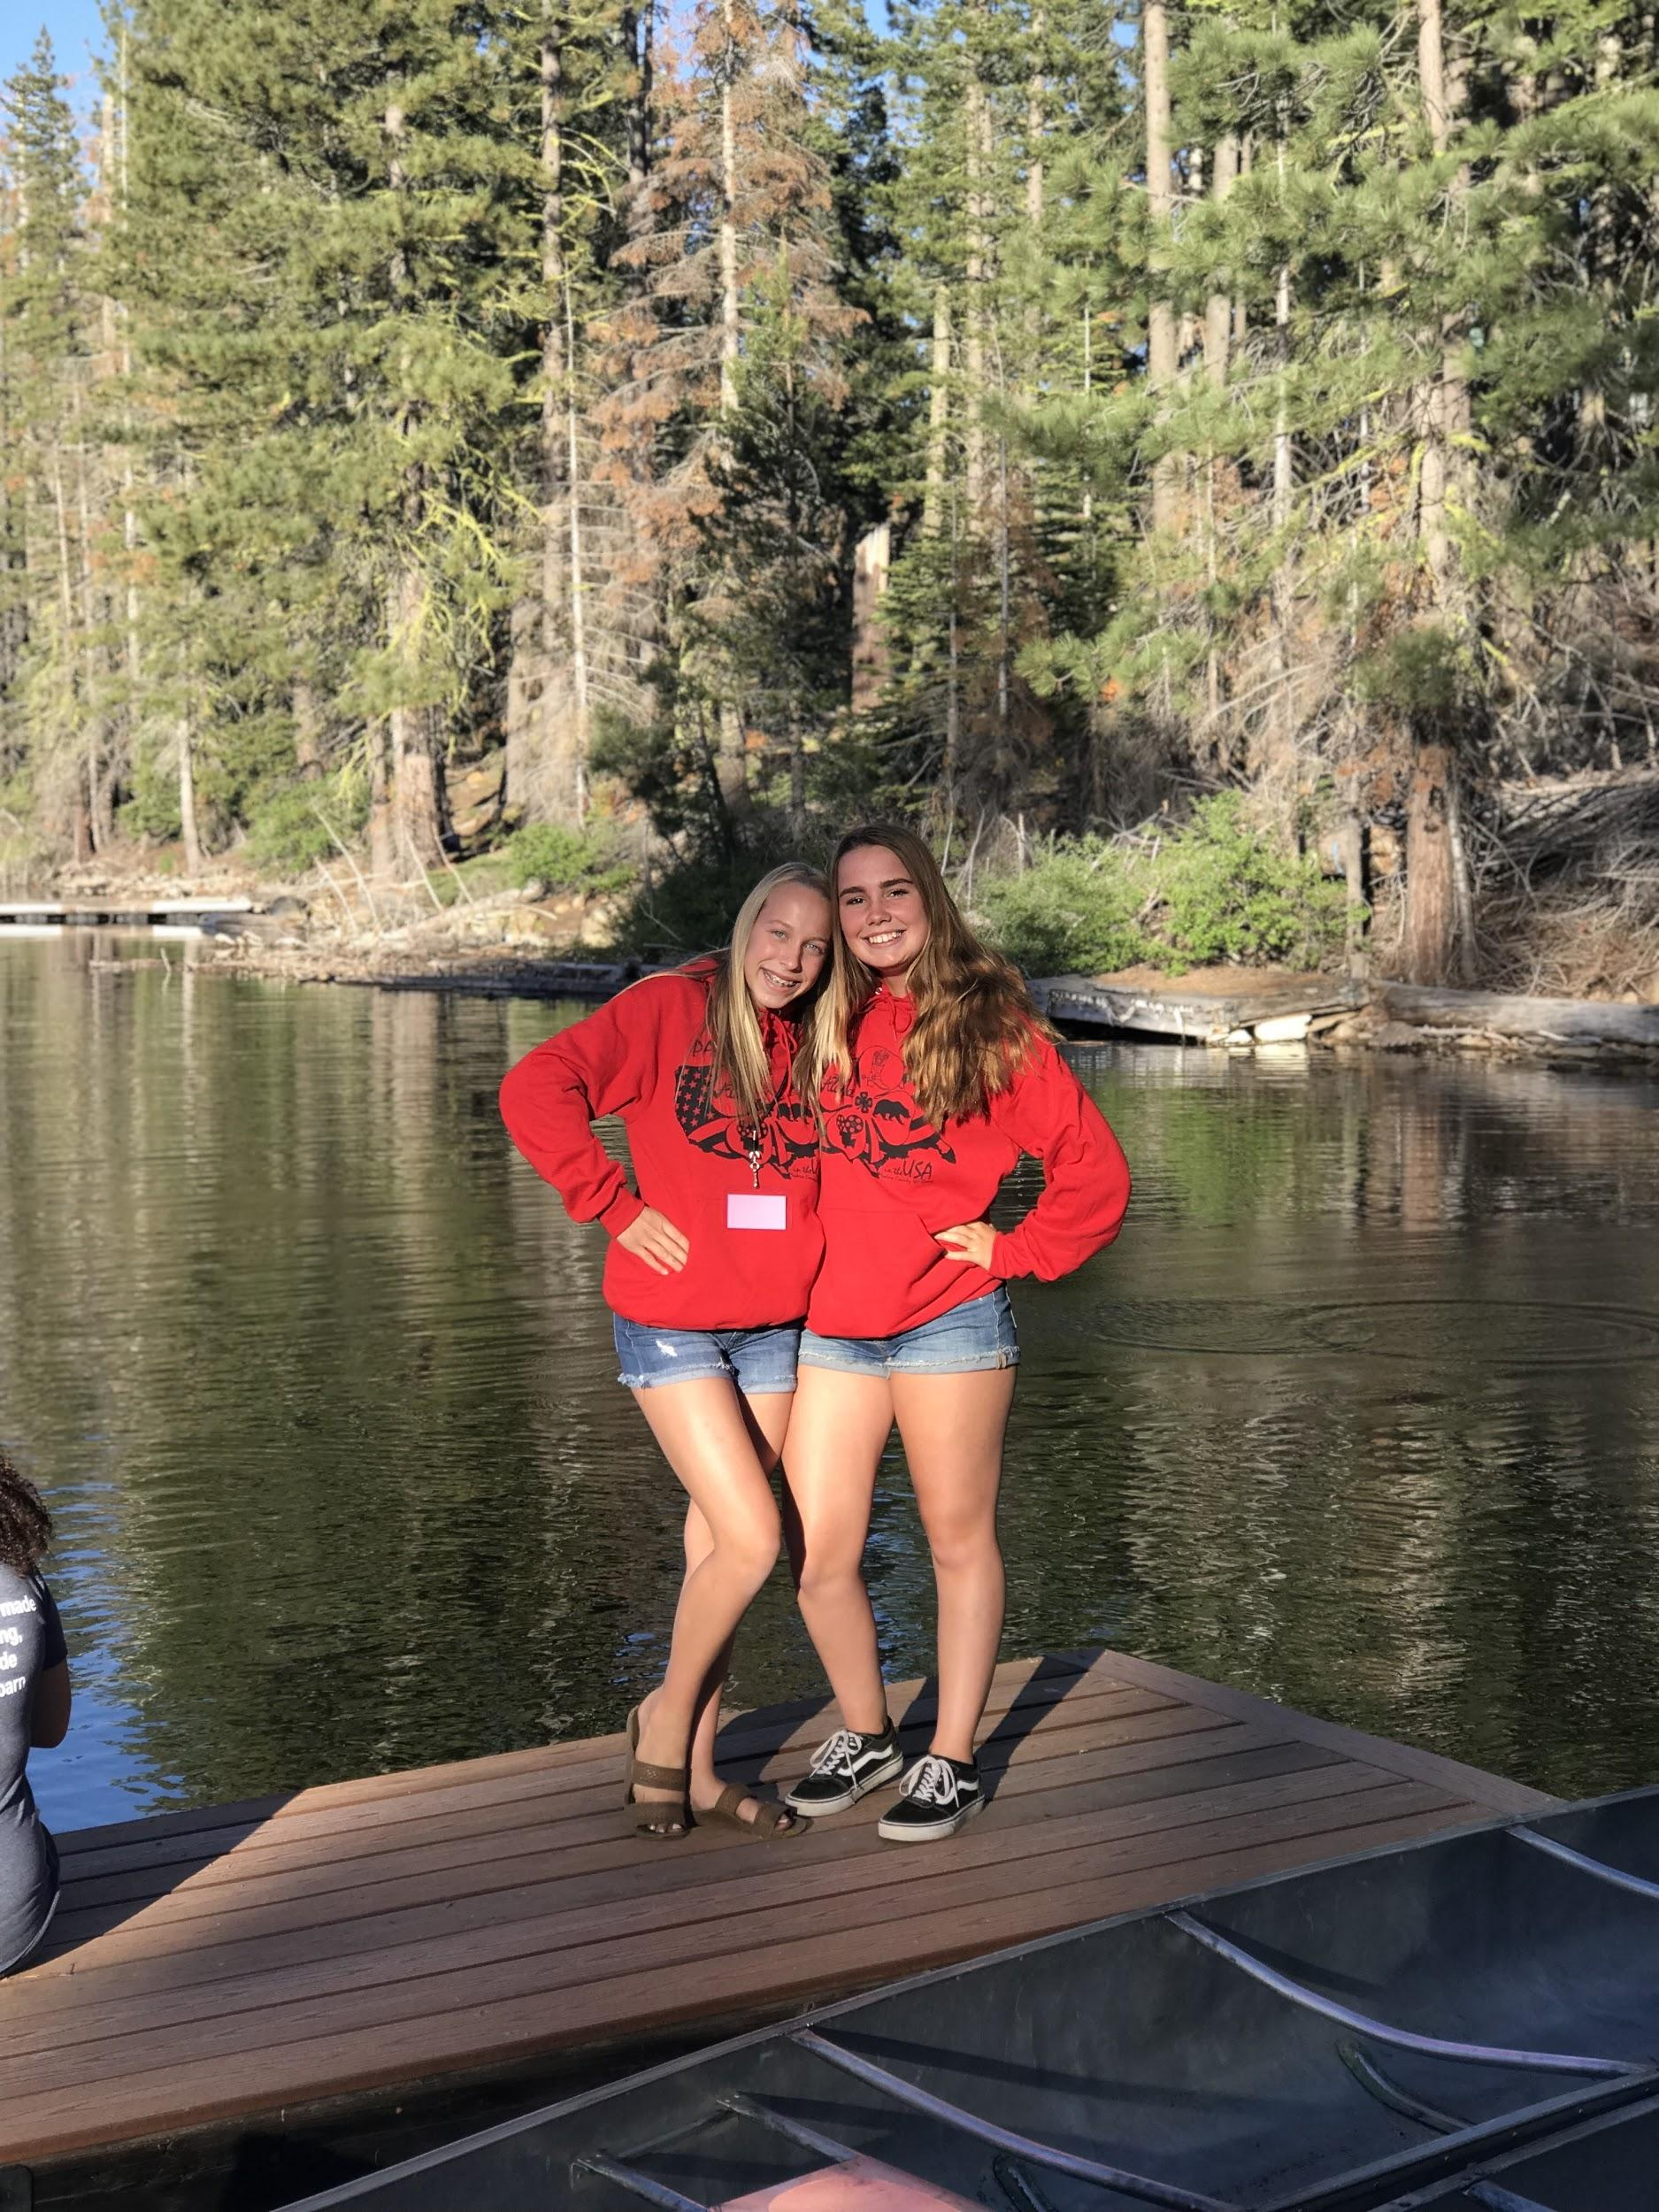
Held at Camp Keola
Huntington Lake

Slide 3
What does 4H Camp have to offer?

Slide 4
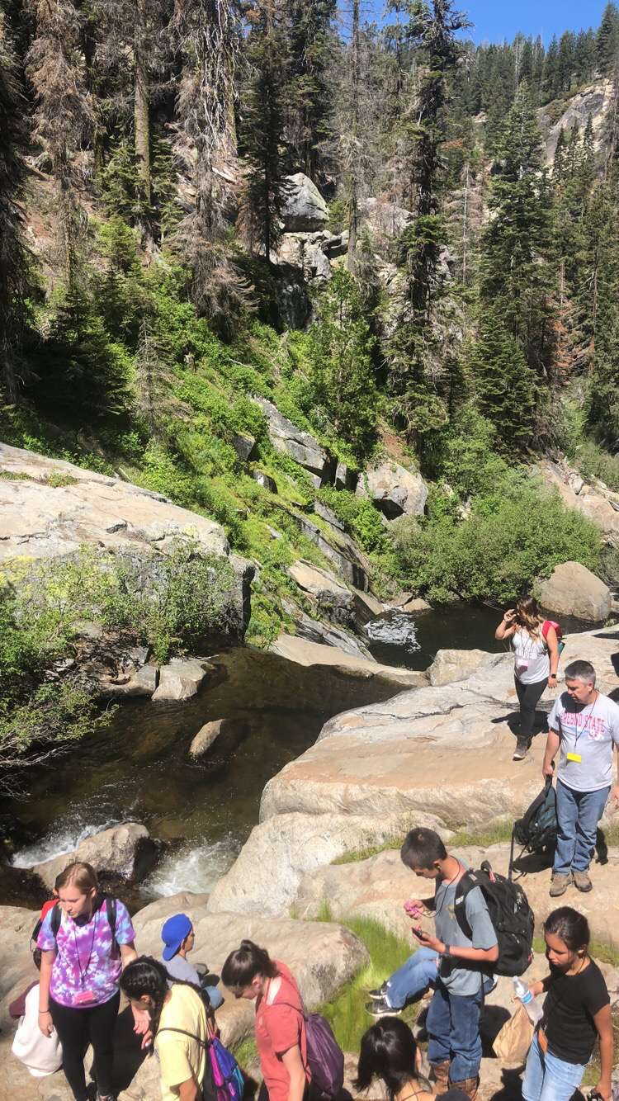
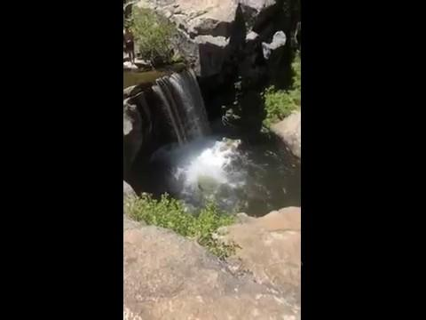
10+ sessions to choose from

Slide 5
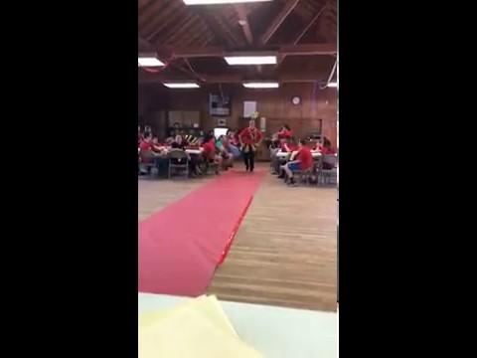
2) Lots of games and activities with your camp teams!

Slide 6
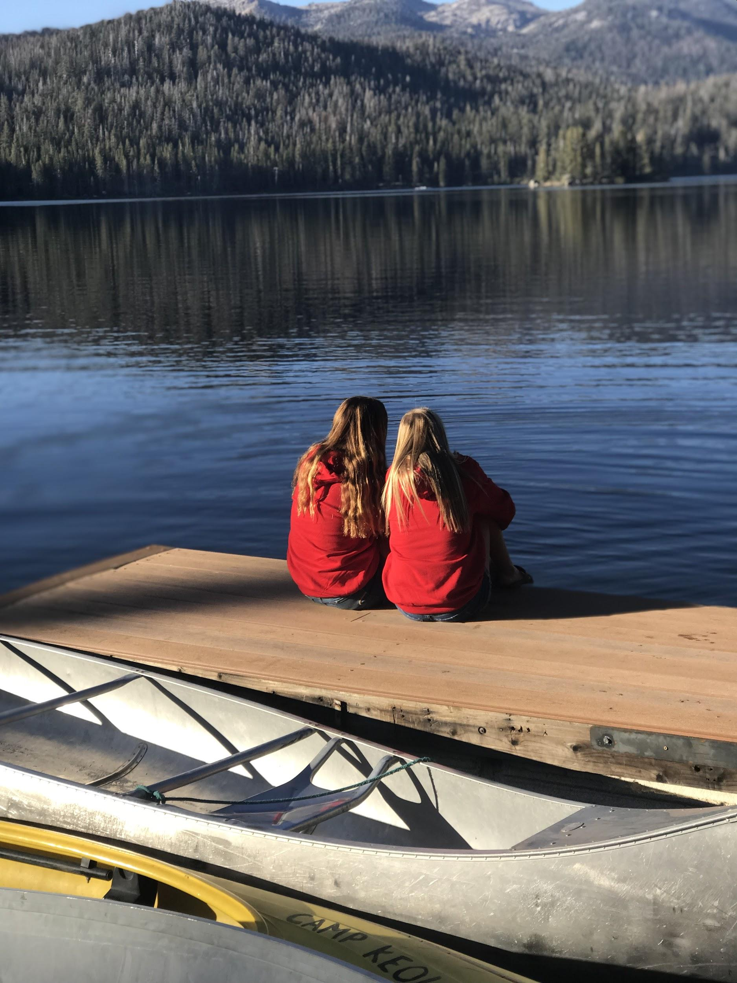
3) Time at the lake!

Slide 7
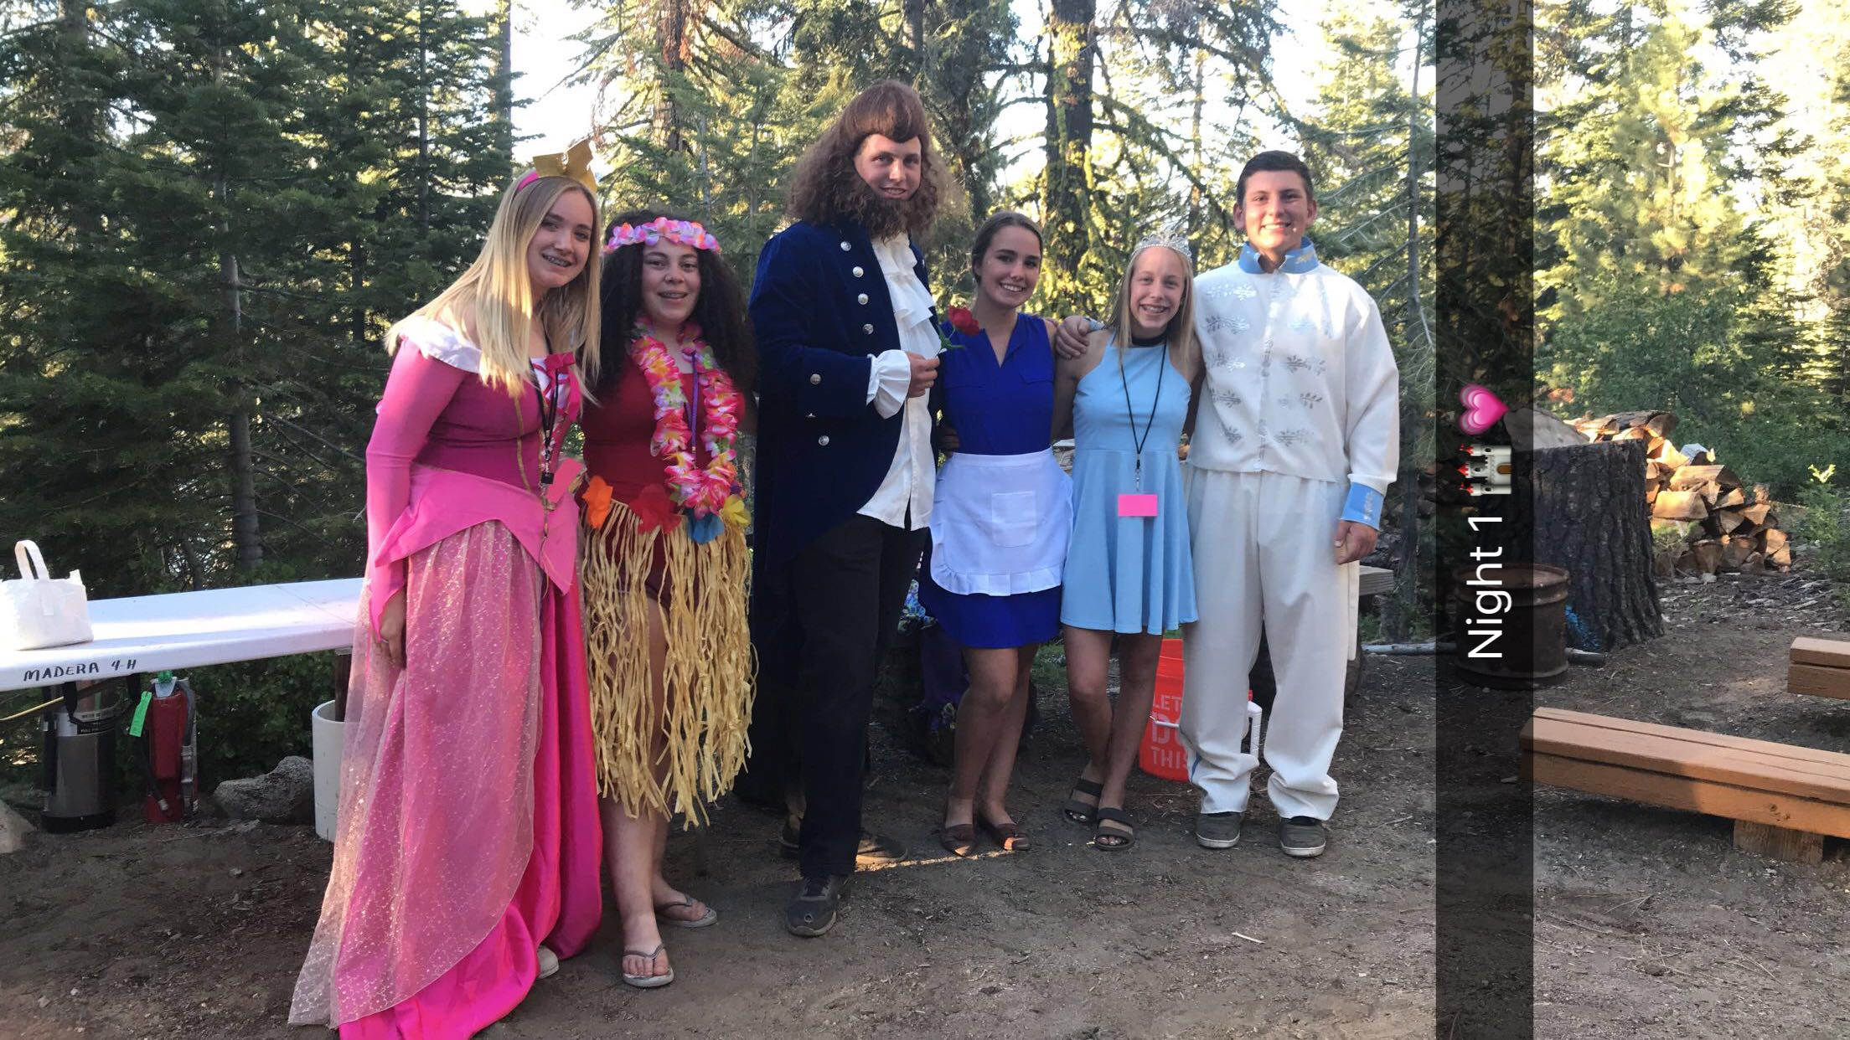
4) Campfire every night where you dress up, sing songs and have a nightlife activity!

Slide 8
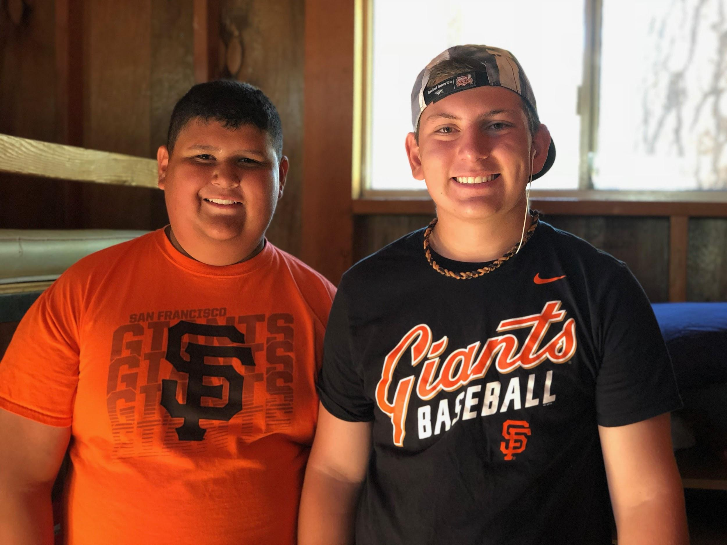
5) Most importantly, it’s a great opportunity to create awesome memories!

Slide 9
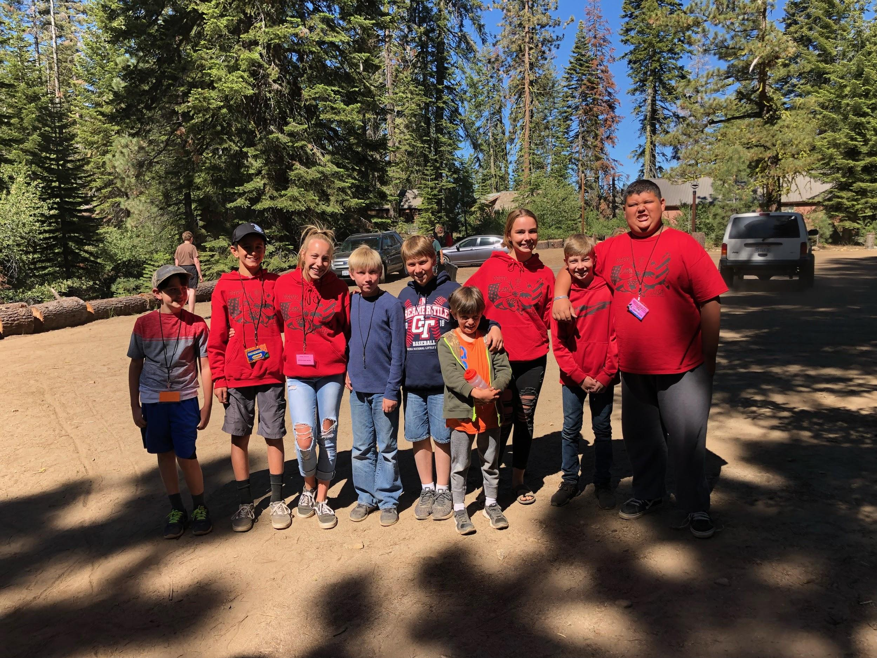
Campers arrive on June 11th and leave on June 15th

Slide 10
Camper and camp counselor applications are DUE to the 4H Office on February 5th and the money is due May 6th!

