Slide 1
4-H Guidelines for Social Media and Online Presence
Lea O’Reilly, University of California Agriculture and Natural Resources

Slide 2
Are we allowed to use social media?
YES!
You are allowed to use social media and websites to
promote your club and communicate with your 4-H community.
There are just a few basic guidelines set by the state and county offices that we need to follow.

Slide 3
What is the scope of Social Media?
Websites & Email Lists
Facebook Pages and Groups (profiles for clubs or projects are not permitted)
Instagram
YouTube
Snapchat (because of the nature of Snapchat, Snapchat accounts are not permitted)
Pinterest
Any online technology that allows users to develop and share their own content

Slide 4
Who do These Guideline Apply to?
Any leader or member managing 4-H Social Media Accounts,
On the 4-H social media accounts (not on your personal account, unless using your 4-H affiliation to push an unauthorized agenda)
All website content
Anyone participating in a 4-H Online Group
(this includes Facebook groups that are open, closed, or secret)

Slide 5
Who can create social media accounts?
4-H Social Media accounts in San Diego County 4-H can be created by any volunteer that is part of the VMO or running a club, advisory board, event, or project.

Slide 6
Who gets administrative rights?
San Diego County 4-H MUST have administrative access to all social media accounts and websites. This includes backend access to websites and usernames and passwords for Instagram, YouTube, Twitter, and any other social media sites that only allow one user.
We recommend (but do not require) that community club leaders have access to all social media accounts for their club. Who wants a phone call or email that there’s an issue they didn’t know about?
Administrative rights may be given to other volunteers and senior 4-H members (supervised) to assist with social media management. Adults that are not current volunteers can not administer to social media.

Slide 7
What are the guidelines?
General 4-H Guidelines First
No posts with text, graphics, video, sound or other media that include profanity, illegal substances (state or federal), alcoholic beverages, illegal weapons, or solicitation and/or advocacy of sexual misconduct.
No promoting specific religious affiliations or political opinions

Slide 8
Cyberbullying
Bullying is against 4-H policy. It can be direct, like calling people names or making threats, or more subtle and passive aggressive (i.e. making comments about the way a 4-H member is dressed or purposefully excluding another 4-H club in an event).
Bullying in all its forms cannot be tolerated. Any comments or posts that are found to be violating this policy must be removed.

Slide 9
Tagging and Naming
#SanDiego4H
@SanDiego4H
Tagging Individuals, Businesses, or unaffiliated Organizations is not permitted.
For Members and Volunteers use initials, age groups, or general terms “one of our 4-Hers,” “these amazing senior members,” “one of our incredible leaders”
Tagging 4-H Clubs or Offices, UCANR, the cooperative extension, or fairs in San Diego County is great
Naming individuals is against safety standards this includes sharing posts that include 4-H members names and posts in your 4-H groups. No matter who posted it.

Slide 10
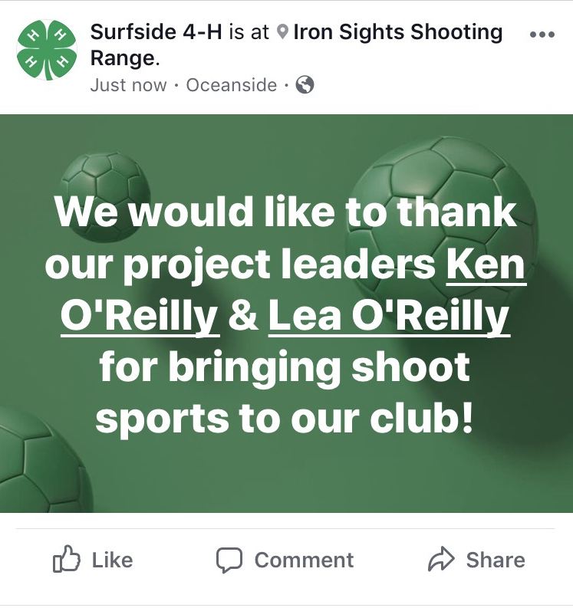
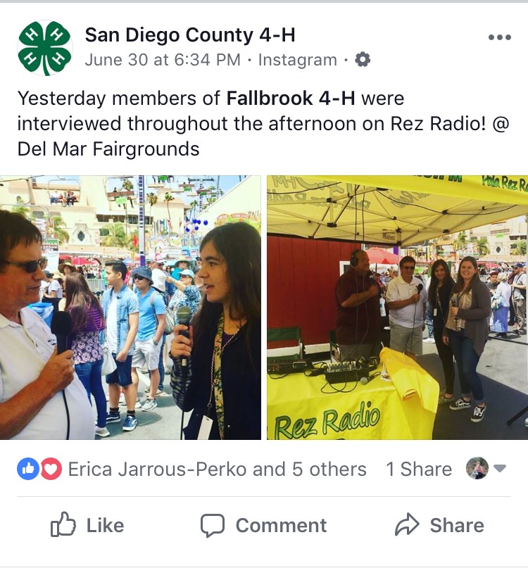
Is there anything wrong with these posts?

Slide 11
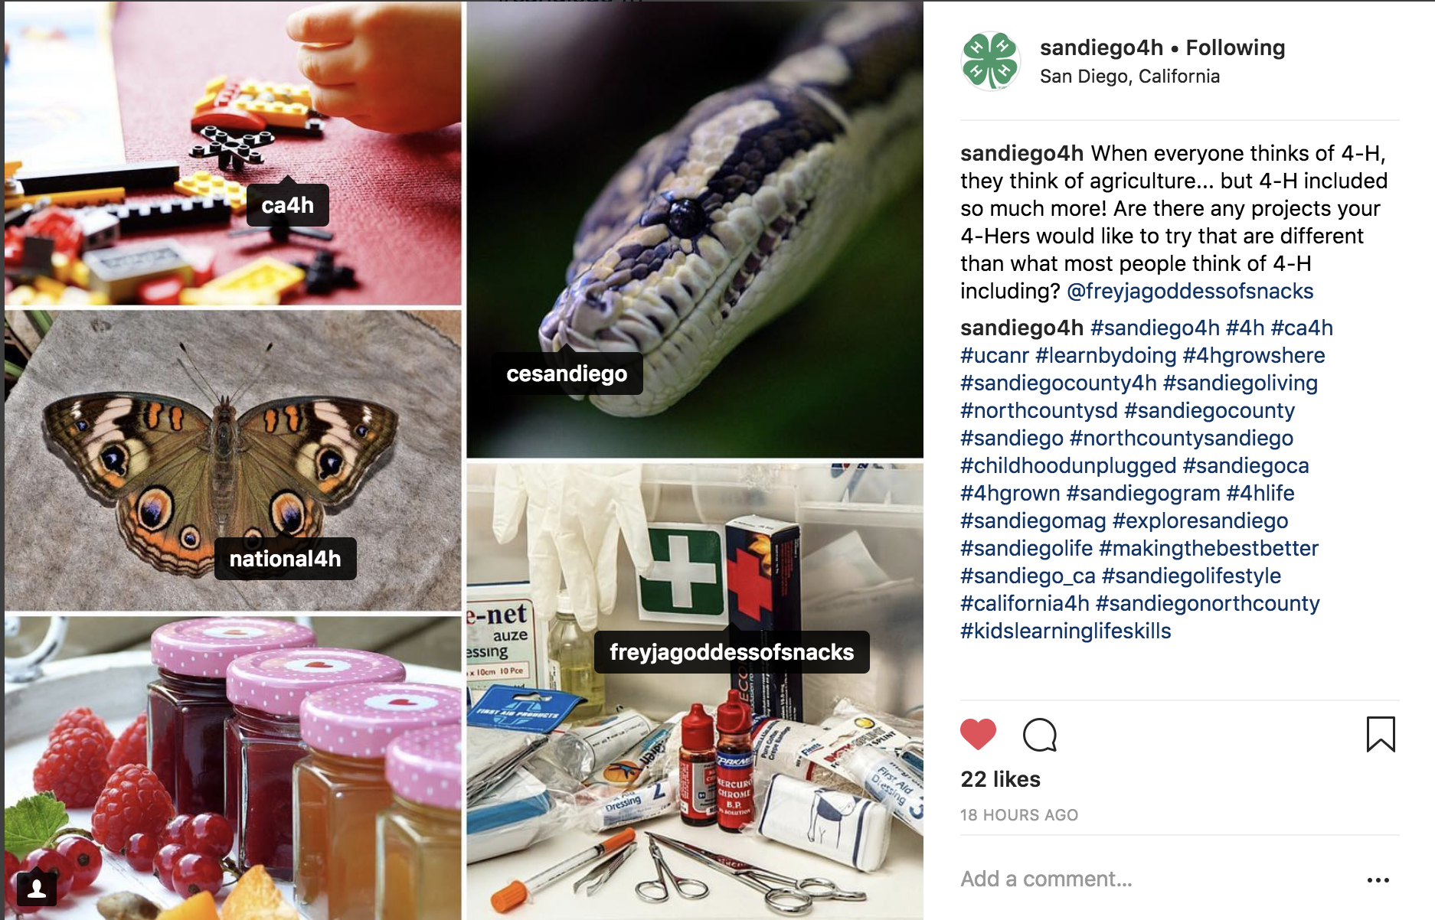

Slide 12
What Harm is There in Oversharing Online?
Fuel for Cyber Bullying
Giving Predators Information
Potential Identity Theft
1 in 6 use a pet’s name as a password
These guidelines are to help ensure that 4-H provides a safe place for youth

Slide 13
Promoting Businesses
Promoting businesses or outside organizations is prohibited
Feel free to check in to a location to show you are there and/or mention in your post that your club is there
Making a business an admin of your 4-H page or group, even your own, is against 4-H policy
Thank businesses or groups that donated to your club

Slide 14
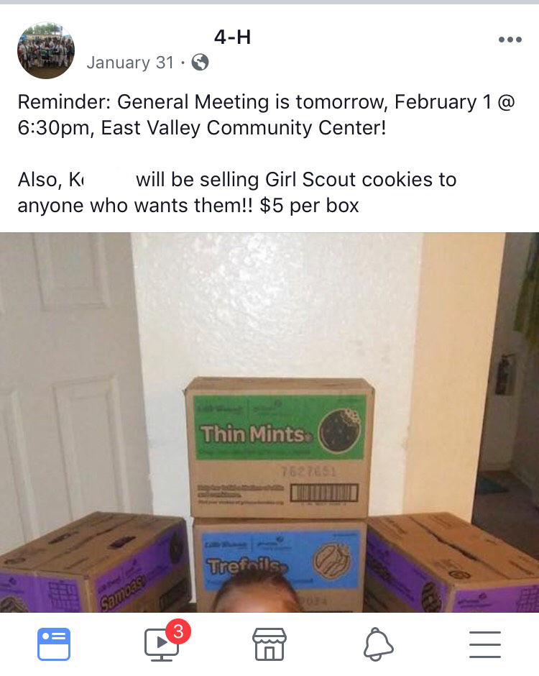
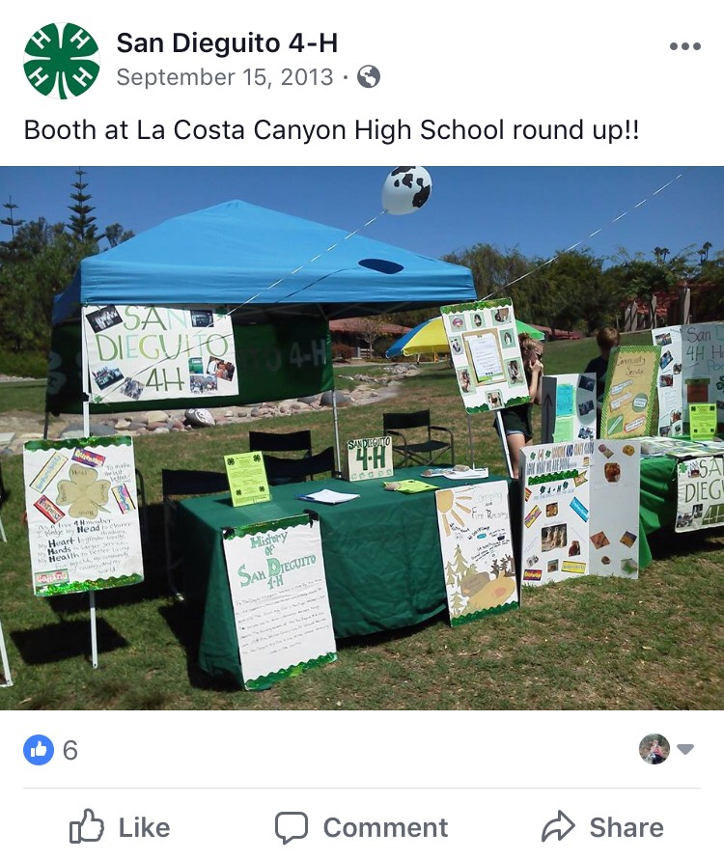
Anything wrong with these posts?

Slide 15
Website & Email Specifics
All of the previous discussed policies are required to be followed on websites & email lists as well, including county access to usernames and passwords.
Both the 4-H logo and the UCANR logo are required and must be on your website.
Websites and emails must have the UC ANR Non-discrimination and Affirmative Action statement
Email specific, the footer of each email sent to a club/project list must include the following statement: “The views expressed in this message are those of the email author and do not represent the California 4-H Youth Development Program.”

Slide 16
What is Copyright & Trademark Law?
Copyright laws protect all intellectual and artistic work and protection starts as soon as a work is created.
Images, videos, theatrical performances, etc require the consent of the creator to share. Memes and other images created by someone else may not be shared in 4-H accounts without the creator’s consent.
Trademark laws cover any word, phrase, symbol, or design that helps identify a brand.
Violations of copyright and trademark laws can result in the person who violated the policy receiving a bill of up to $25,000 per copyright infringement.

Slide 17
Doesn’t 4-H fall under Fair Use?
Fair Use is the part of Copyright law that allows for parts of a Copyrighted material to be used for reporting, teaching, criticizing, or researching without requiring permission from or payment to the copyright holder.
The only time that 4-H volunteers may use materials under Fair Use is during meetings. Materials at events, competitions, or shows DO NOT fall under fair use.
4-H members MAY use copyrighted materials for educational displays and presentations under Fair Use.

Slide 18
For Further Questions on Social Media
Feel free to contact me at (858) 822-7933
LBOReilly@ucanr.edu

